Slide 1
Safe Winter Driving

Slide 2
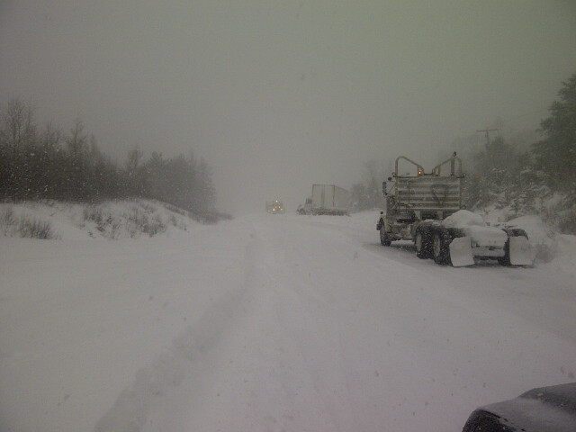
Traffic Staff Sergeant Ken Mantey
Regional Manager-Traffic and Marine
OPP-Northwest Region
(807) 473-2723 (w)
(807) 629-7073 (c)
kenneth.mantey@opp.ca

Slide 3
Driving is not easy
As a driver you must process a tremendous amount of information the entire time that you are behind the wheel
Constant scanning, anticipating and planning
More demanding than most drivers realize

Slide 4
Safe Winter Driving
wipeout - Highway Safety website

Slide 5
Safe Winter Driving
Preparation
Vehicle Knowledge
Observations/Hazards
Limit Distractions
Responsibility

Slide 6
Prepared Yourself!
Weather forecast
MTO road conditions (511 or www.ontario.ca/trip)
OPP Twitter OPPCommunicationsNWR@OPP_COMM_NWR
Long trips, emergency kits, blankets, cell phone charger
You should not be leaving for work at the same time during the winter

Slide 7
Prepare Yourself
Always wear your seat belt. Seat belts are the best defense against other unsafe drivers.
2013, 373 people injured or killed in MVC’s, 92 were not wearing seatbelts (25%)
2012, 390 injured/killed, 76 were not wearing seatbelts (19%)
2014, 327 injured/killed 93 were not wearing seat belts (28%)

Slide 8
Prepare your vehicle
Ensure your vehicle is serviced and running properly
Tires inflated properly
Windshield wipers/washer fluid
Clean the snow from your vehicle!

Slide 9
Be Prepared

Slide 10
Be Prepared
Be smart! Clear off your car before hitting the road
By Corey Larocque, Ottawa Sun First posted: Tuesday, January 06, 2015 03:08 PM EST | Updated: Tuesday, January 06, 2015 03:21 PM EST
Sandra Plagakis, got a crash course in winter's power and a firsthand lesson in how dangerous it is when drivers don't clear the snow and ice from their vehicles. Plagakis's car was hit with a sheet of ice on Tuesday morning on Hwy. 417

Slide 11
Be prepared

Slide 12
Vehicle Knowledge
Heat selection, rear defrost
Rear, front, four or all wheel drive
Tires, summer, all season, winter, studded
Lights, daytime running lights
Cruise control? Traction control?

Slide 13
Observation/Hazards
We have to be cognizant of changing road and weather conditions
If the temperature is very cold and the pavement looks wet/shiny (Black ice?????????)
Snowbanks
Snow plows

Slide 14
Observe

Slide 15
Did they Observe?

Slide 16
Did they Observe?

Slide 17
Did they Observe?

Slide 18
Observe
concentration - Highway Safety website

Slide 19
Slow Down!
Speed too fast for conditions is a significant causal factor for MVC’s in the winter
38% of all MVC’s in NWR from 01Nov-01Apr were caused by speed too fast, Speed excessive or loss of control

Slide 20
Slow down
SpeedDifference - Highway Safety website

Slide 21
Leave Space!
Leave space between your vehicle and the vehicle in front of yours
This distance should increase as speeds increase, road conditions/visibility deteriorates

Slide 22
How does this Happen

Slide 23
Leave Space Between Vehicles

Slide 24
Distractions

Slide 25
Distracted

Slide 26
Distraction?
HumanFactor - Highway Safety website

Slide 27
Distracted
2012 17% of all Motor Vehicle Collisions (MVC’s) involved some type of distraction (606)
2013 18% (670), 2014 YTD 20% (639)
Fatal MVC’s 2011-2014
63 Fatal MVC’s
20 (31%) were caused by a type of distraction (50% 2009-2010)

Slide 28
Who knows???

Slide 29
Top Speed?

Slide 30
Late!

Slide 31
Responsibilty
We are responsible for each others safety on the highway
Road conditions are not an excuse for poor driving
Ask yourself the question do I really need to driving during a snow storm

Slide 32
Drive safely, it is the most important part of your day!
Questions?

