Slide 1
Crisis and Time For Change: Shifting Our Thoughts Around Substance Use Disorder
Dr. Louisa Marion-Bellemare
Oshki-Nochmoowin Conference
February 6, 2024

Slide 2
WHAT ARE OUR BIASES?

Slide 3
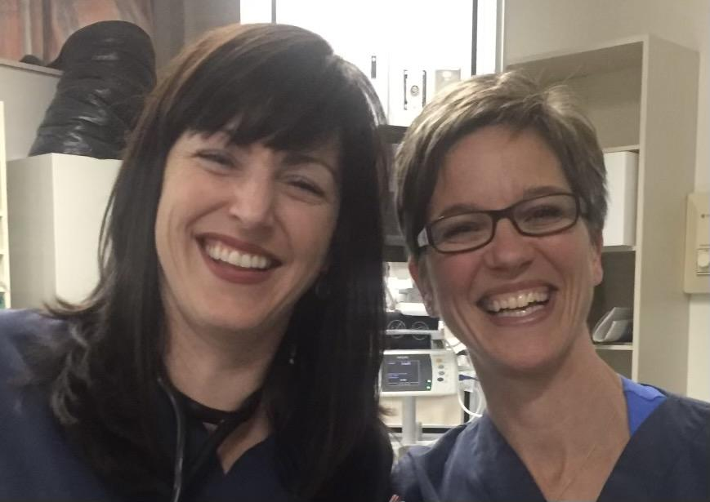
It’s a willpower issue..they should be able to stop
They should be taken off the medication as soon as possible
Suboxone is just replacing one drug for another

Slide 4
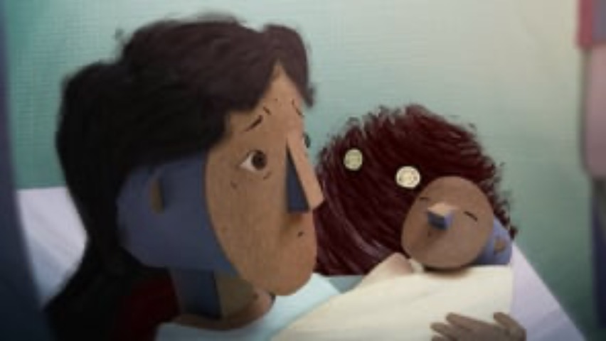


Slide 5
https://subjectmatter.ca/work/circlesofcare/

Slide 6
Definition of Substance Use Disorder (SUD)
Medical condition defined as :
Chronic Relapsing illness which, though associated with elevated rates of morbidity and mortality, has the potential to be in sustained remission with appropriate treatment (CRISM, 2018)
Compulsive disorder with a strong desire to stop or cut back but an inability to do so despite risk and consequences
  “MEDICALIZATION OF SUD/OUD CAN REDUCE STIGMA”

Slide 7
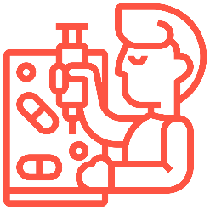


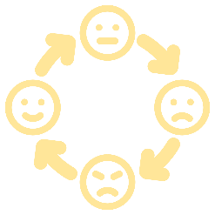



Addiction
High Risk & Addictive Behaviour
Emotional Dysregulation
Development of Character, Personality and Coping Skills
Adverse Childhood Experiences
Genetic Predisposition
Pyramid of Addiction

Slide 8
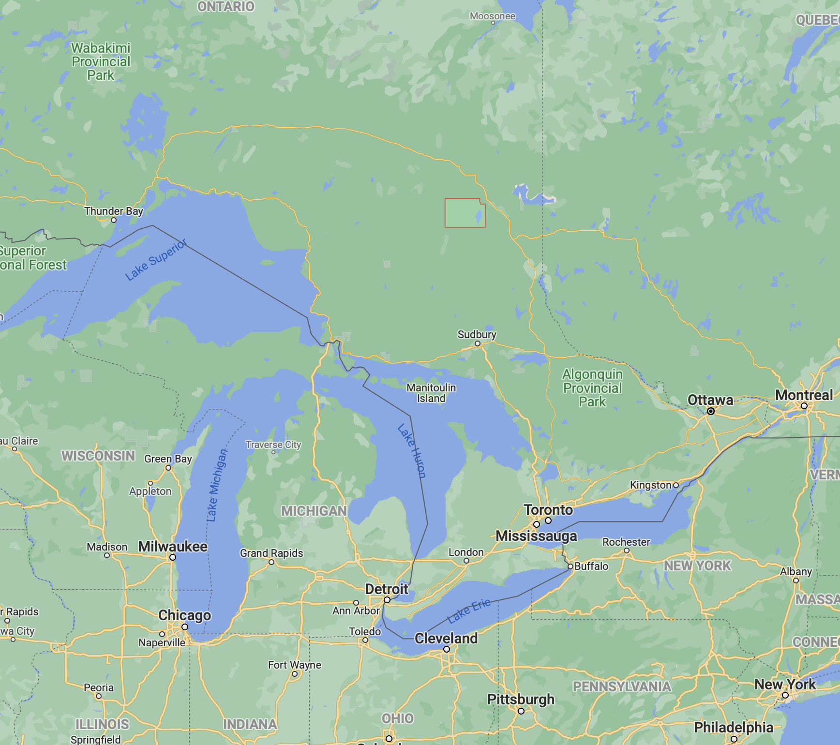

NORTHERN ONTARIO CRISIS AND TIME FOR A CHANGE
THUNDER BAY
TIMMINS

Slide 9

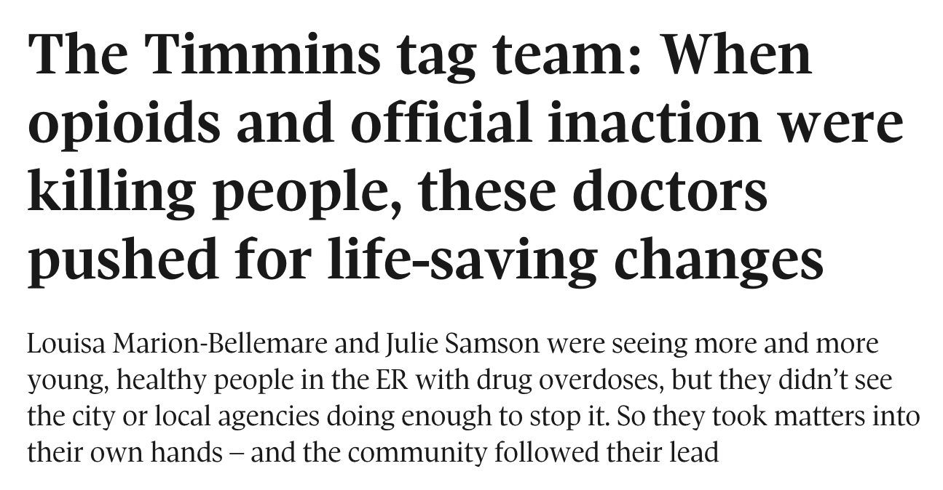

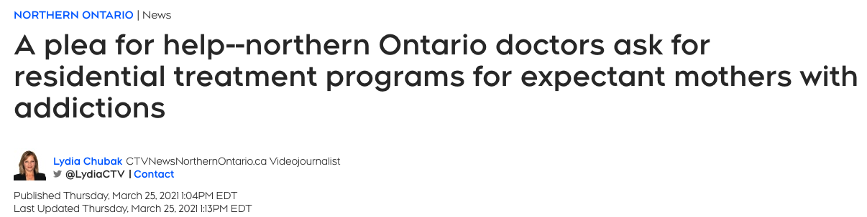
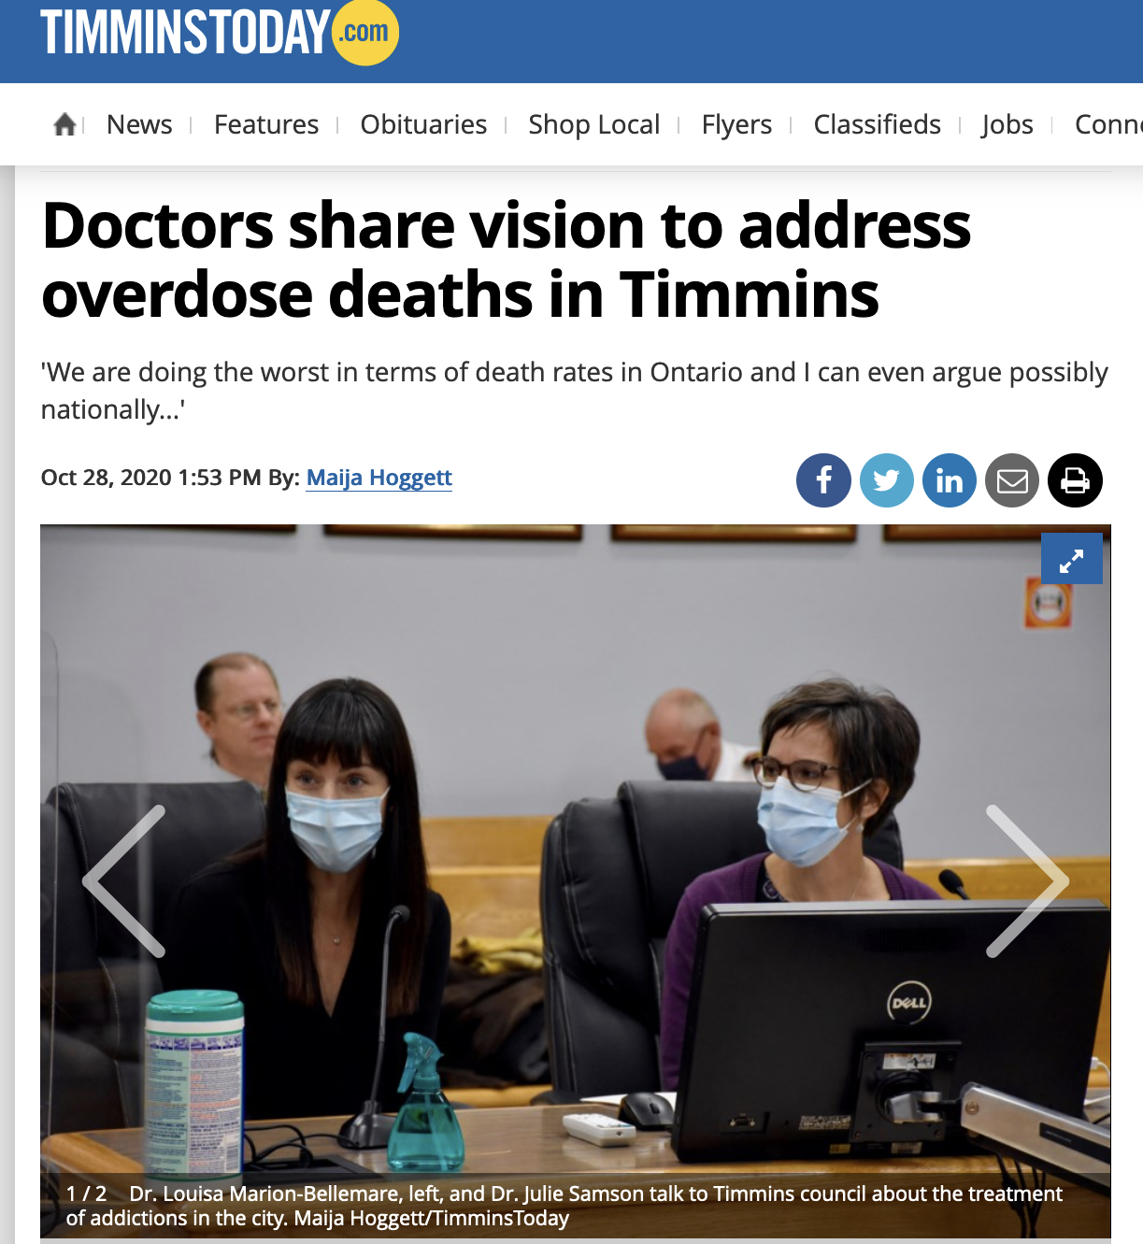
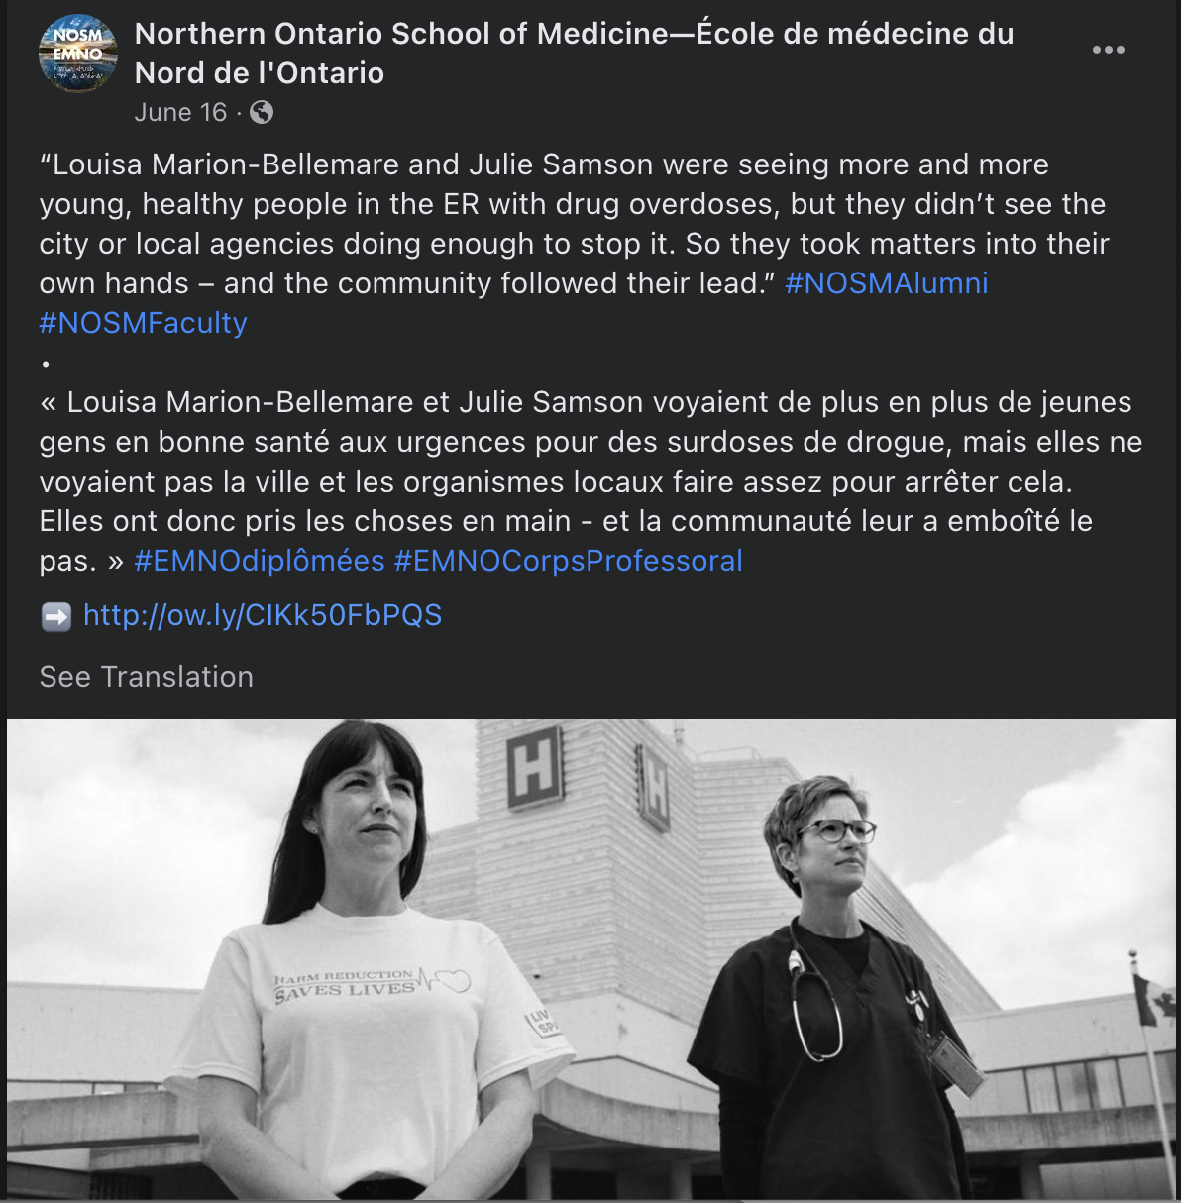
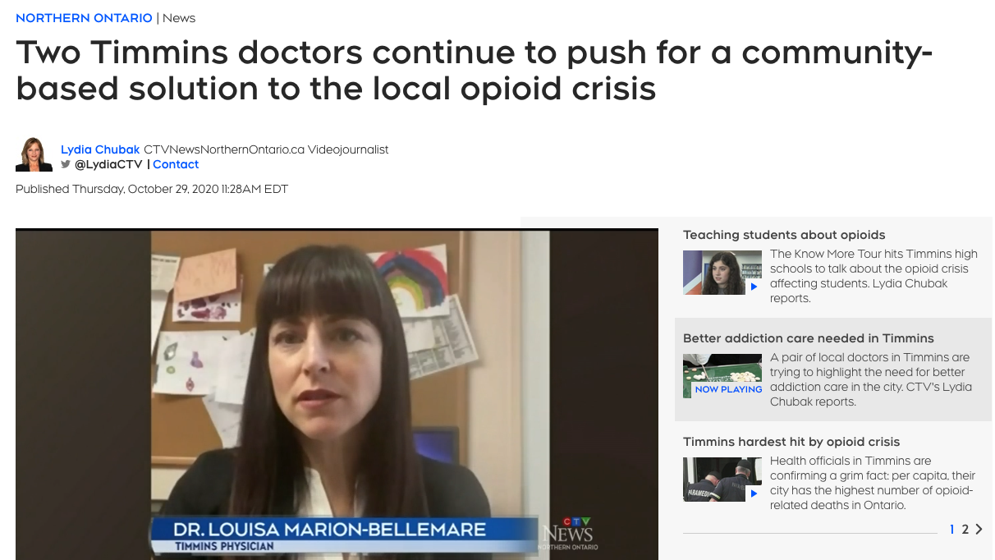

Time for a Change: Inspiring the Community
Notes:
Drs Samson and Marion-Bellemare did about 20 presentations to community organizations
Presented to hospital medical board, city council, medical advisory committee, EDs of community organizations, fire department, EMS
Convinced people who didn’t care to do something
Convinced needed to do this to save lives

Slide 10
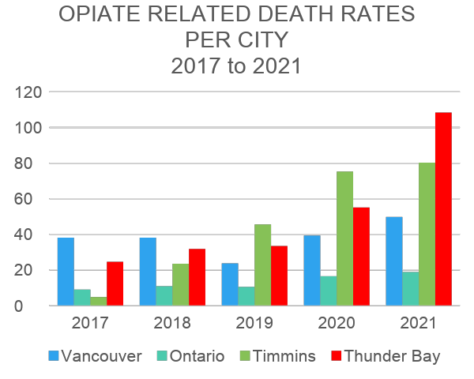
LOCAL CRISIS
Data Source: https://www.publichealthontario.ca/en/data-and-analysis/substance-use/interactive-opioid-tool
https://www2.gov.bc.ca/assets/gov/birth-adoption-death-marriage-and-divorce/deaths/coroners-service/statistical/illicit-drug.pd
*2021rates are preliminary and subject to change²
f
Notes:
Other cities for 2021
TB: 108.4
Timmins: 80
SSM: 69.4
NB: 49.4
Sudbury 48.8
Ontario: 18.8
PHU (Porcupine Health Unit) population: ~ 85 000
Timmins population: ~42 000
Vancouver Coastal Health: includes Vancouver East Side
CCO
Ontario
2020: 2426 deaths which is a 60 % increase from 2019
https://www.publichealthontario.ca/en/data-and-analysis/substance-use/interactive-opioid-tool
https://www2.gov.bc.ca/assets/gov/birth-adoption-death-marriage-and-divorce/deaths/coroners-service/statistical/illicit-drug.pdf

Slide 11
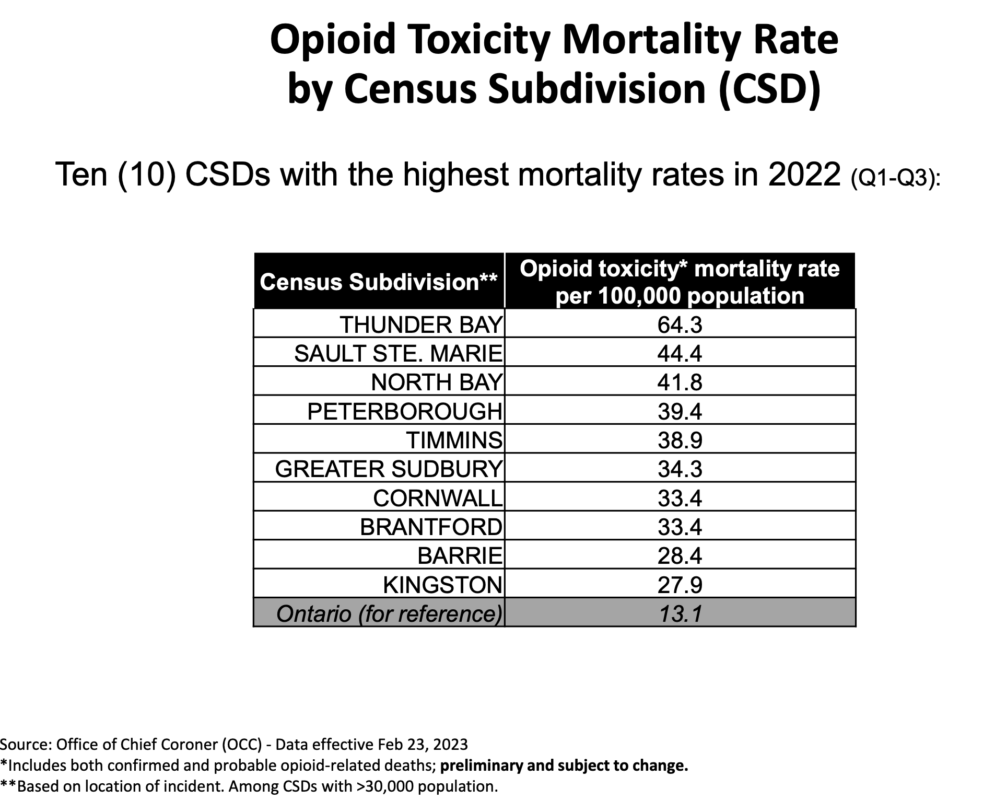

Slide 12
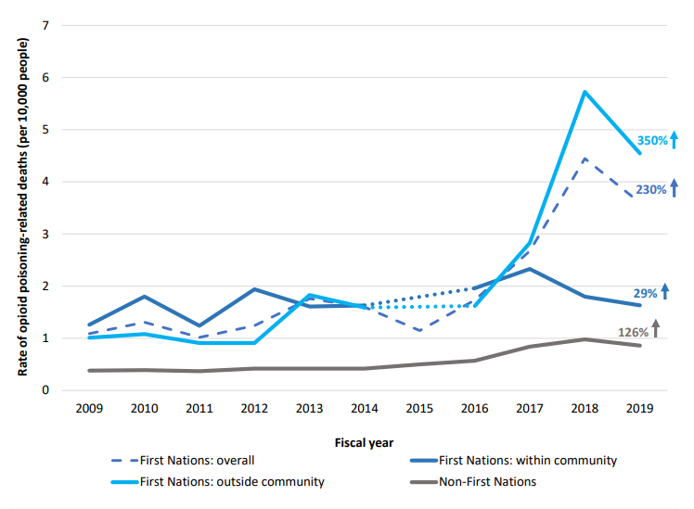
Race & Indigenous identity
Who is dying from opioid toxicity?
The OCC has implemented a process to make the collection of race and Indigenous identity a mandatory requirement as part of death investigations. The data collected will align with the Anti-Racism Directorate data standards and will include First Nations, Métis, and Inuit categories for all death investigations.
The OCC is seeking engagement to co-develop an approach to release race-based data. Future work is planned to study the impacts of the ongoing overdose crisis among Black, Indigenous and People of Colour in Ontario, in a collaborative effort with community organizations.
The following results by Indigenous identity are from a report released by the Chiefs of Ontario in collaboration with the Ontario Drug Policy Research Network*
Rate of opioid poisoning-related deaths in Ontario, from 2000 to 2019
Beginning in 2017 opioid mortality rates increased disproportionately among First Nations people, particularly among First Nations people living outside of First Nations communities.
*Opioid Use, Related Harms, and Access to Treatment among First Nations in Ontario, 2013 – 2019
https://odprn.ca/wp-content/uploads/2021/11/First-Nations-Opioid-Use-Harms-and-Treatment-Report.pdf

Slide 13
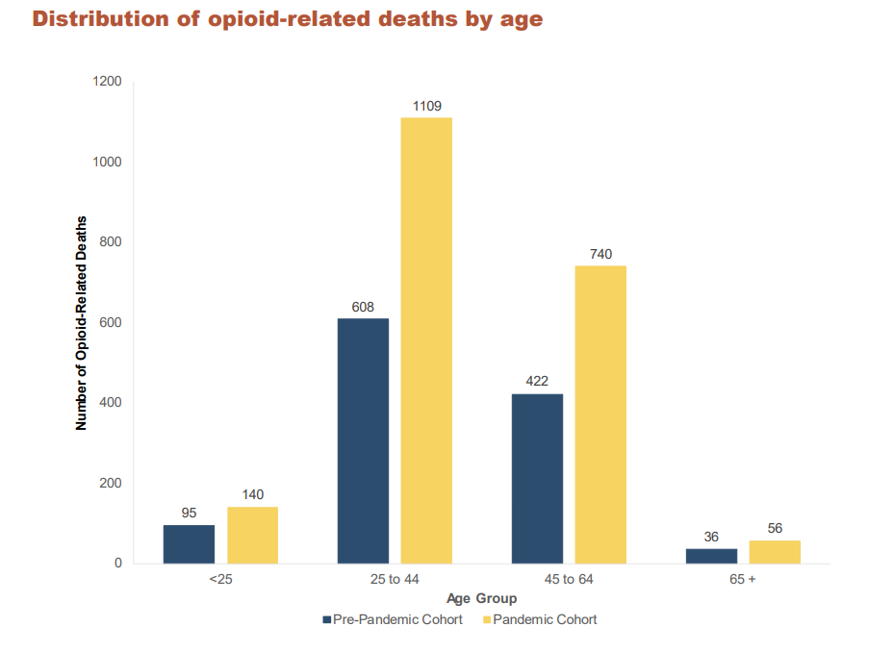
https://odprn.ca/wp-content/uploads/2022/01/Opioid-Related-Toxicity-Deaths-and-Healthcare-Use-Report.pdf
Notes:
Opiates kill more 25-44 yo people than cancer, MVC , cardiovascular

Slide 14
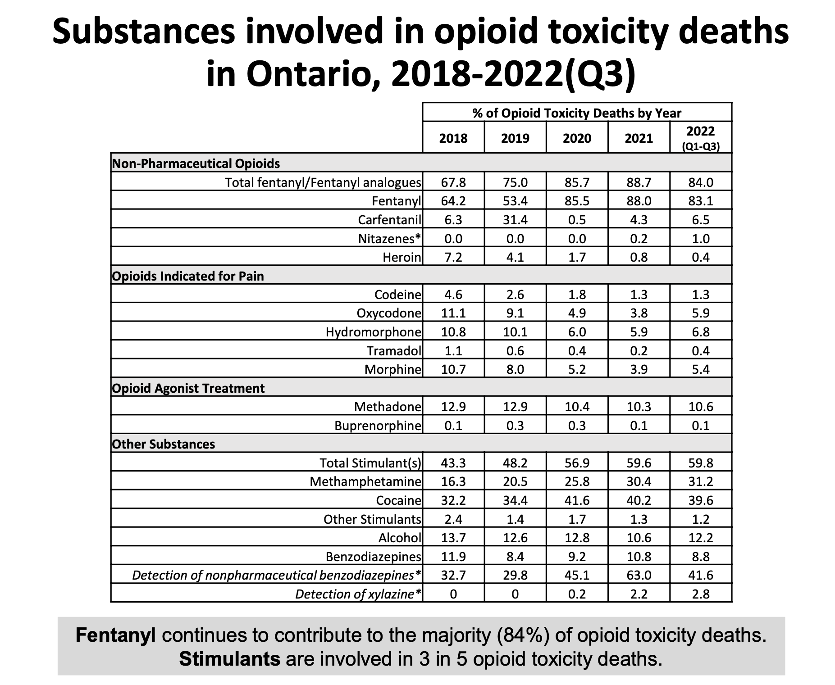
BUP/NAL is very safe

Slide 15
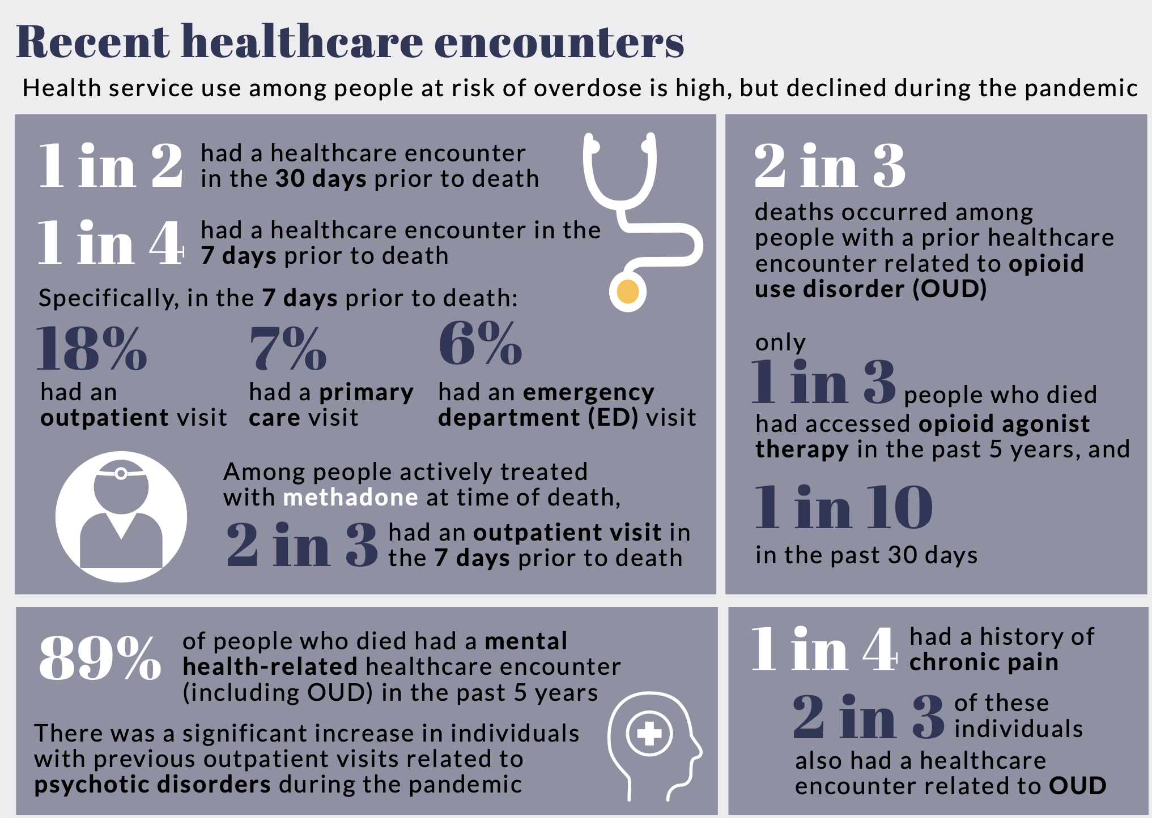
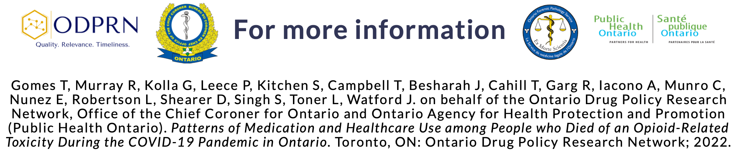

November 2022
Notes:
Infographic from Public Health Ontario from November 2022

Slide 16
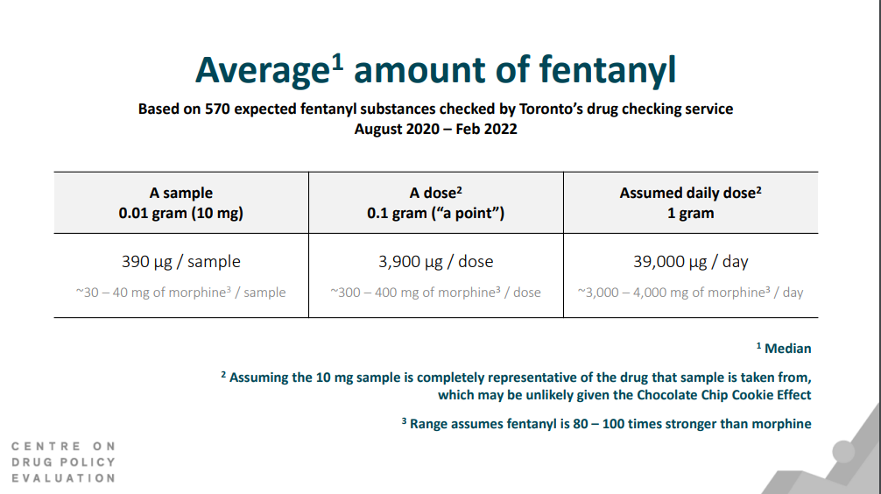
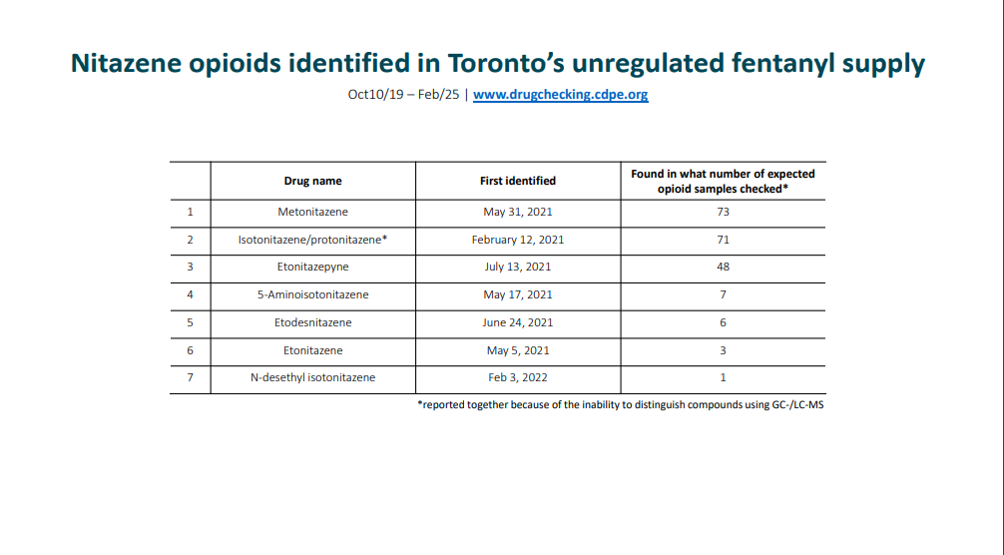

Slide 17
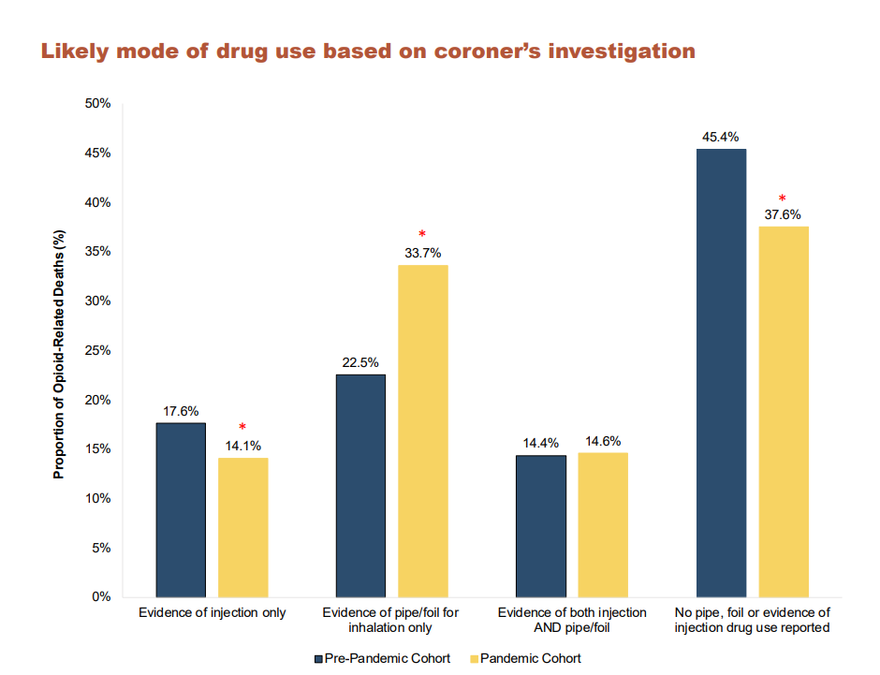
https://odprn.ca/wp-content/uploads/2022/01/Opioid-Related-Toxicity-Deaths-and-Healthcare-Use-Report.pdf

Slide 18
Progress In OUD Treatment Options
1990
2000
2010
2020
Long-acting
Depo
treatment
available
Methadone
(full agonist)
Buprenorphine
(partial agonist)
Sublingual buprenorphine-naloxone
New induction strategies
Emergence of fentanyl and analogues, novel opiates & contaminated drug supply
Notes:
Challenge of oxycodone in the 1990s, methadone only treatment available
Methadone and buprenorphine are both oral treatments
Relieve withdrawal symptoms, inhibit euphoria
Success is dependent on patient adherence
Buprenorphine advantages: better safety, lower stigma
Methadone has strict regulatory environment, buprenorphine less so, allowing clinicians to use their own judgment
Home inductions developed to deal with fentanyl

Slide 19

TOXIC
TWINS
Notes:
Why and how did these guys make it? In their 80’s and a life of opioid use
Heroin is a bit more predictable🡪 lasts longer, not typically contaminated
Never got in to fentanyl

Slide 20

Gone are the days of Tweeter and the Monkey Man
Notes:
Gone are tweeter and monkey man days
They were hard up for cash so they stayed up all night selling cocaine and hash
Now it is fentanyl which is potent and now contaminated
Even Tom Petty— who had everything died at age 66 of a fentanyl overdose in 2017 so imagine the challenges our patients living on streets have trying to come off or quit fentanyl
I gave tickets away for a Tom Petty concert in July 2017 to go to Julie’s cottage and he died in Oct 2017

Slide 21
ADDICTION IS AN EMERGENCY
Untreated Addiction is Life Threatening
Risk of Death Increases in the days, months and years following Non Fatal OD
Seeking help is a fleeting moment with a magnitude of an emergency
Notes:
similar to MI
Relapse rates are increased without OAT 60-90% , increasing risk of mortality and death

Slide 22
OVERDOSE & SHORT TERM MORTALITY
ED PATIENTS WITH NON FATAL OPIOID OVERDOSE:
5% one year mortality post ED discharge
Of patients that died, 20% died in the first month
Of those that died in the first month, 22% died within the first 2 days
Source: Weiner,Scott et al..One-Year Mortality of Patients After Emergency Department Treatment for Nonfatal Opioid Overdose. Annal of Emergency Medicine. April 2, 2019

Slide 23


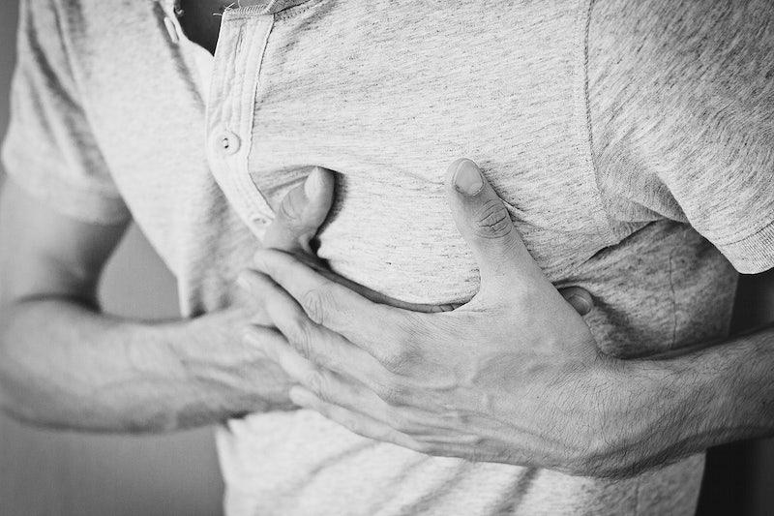
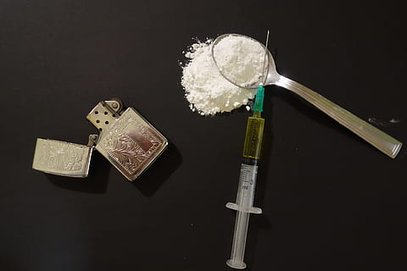


Of patients who died,
0.12% died
7 days after their visit to the ER
Of patients who died,
4.4% died
2 days after their visit to the ER
Notes:
Here are some interesting statistics:
ER stats (susceptibility to overdoses)
- Of those people presenting to emerg with chest pain, 0.12% died 7 days after leaving the emergency room
- Of those presenting to the emergency room after a non fatal overdose, 4.4% died 2 days after leaving the emergency room
- This is a 40 times more chance that someone will die from an OD within 2 days after leaving the emergency after a non fatal OD compared to someone with chest pain within 1 week

Slide 24
What is in Drugs Today?
Dealing with pharmaceutical opiates
  Percocet, oxycontin
2020
2010
Dealing with non pharmaceutical opiates and synthetic opiates
Heroin
Fentanyl and carfentanil
High risk of contamination
Notes:
Prescription drugs have gone down - doing better
But increase opiate related od deaths - due to non prescription opiates

Slide 25
Names of Drugs Today
Fentanyl (heroin, down, purp)
Crystal Meth (Methamphetamine, JIB, Meth)
Amphetamine (tabs, speed)
Crack (Cocaine)
Cocaine
Benzodiazepines
Alcohol

Slide 26
Why We Need to Treat Opioid Addiction with OAT
FENTANYL IS THE NEW DRUG OF CHOICE
Very Potent and Addictive
High overdose risk
Withdrawal symptoms are severe and practically intolerable
Stored in fat so makes it hard to abstain long enough to treat the addiction
Significantly Contaminated/Toxic Drug Supply
ABSTINENCE (no treatment)
Relapse rate 60-90%
High mortality both while incarcerated and at release
High morbidity
  Subsequent overdose
  Suicidality
  Other sequelae (e.g., endocarditis)
  Social instability

Slide 27
Evidence of OAT Effectiveness in OUD
DECREASE IN OVERDOSE RELATED MORTALITY
Decrease mortality by 70-80%
Decrease morbidity:
  HIV
  Hep C
  infective endocarditis
  cellulitis, abscesses
  overdose incidents/drug poisoning
RETENTION RATE IN OAT TREATMENT PROGRAMS
Yearly treatment retention rate 74%
More likely to be:
  in remission
  employed
  have stable housing
  keep families together
Must be STARTED on treatment to REMAIN in treatment

Slide 28





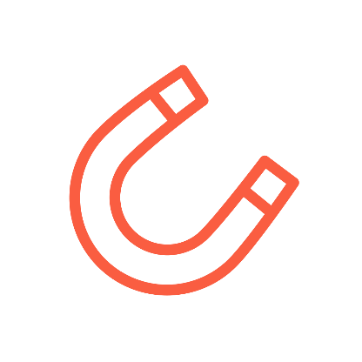


The light bulb is like a drug receptor in your brain
Drugs turn the light bulb/receptor on fully
Drugs are attracted like a magnet to this receptor/light bulb

Slide 29



Drug
Sometimes Keeping a light too bright ends up burning it out

Slide 30
HOW DOES BUPRENORPHINE/NALOXONE (SUBOXONE) WORK FOR OPIOID ADDICTIONS ?

Slide 31



buprenorphine/Nal turns the light bulb/receptor only partly on & this has lots of benefits
fentanyl
BENEFITS INCLUDE:
-Less risk of Overdose
-Less fatigue
-Less brain fog
-Less constipation
-Less sexual dysfunction
Fentanyl

Slide 32
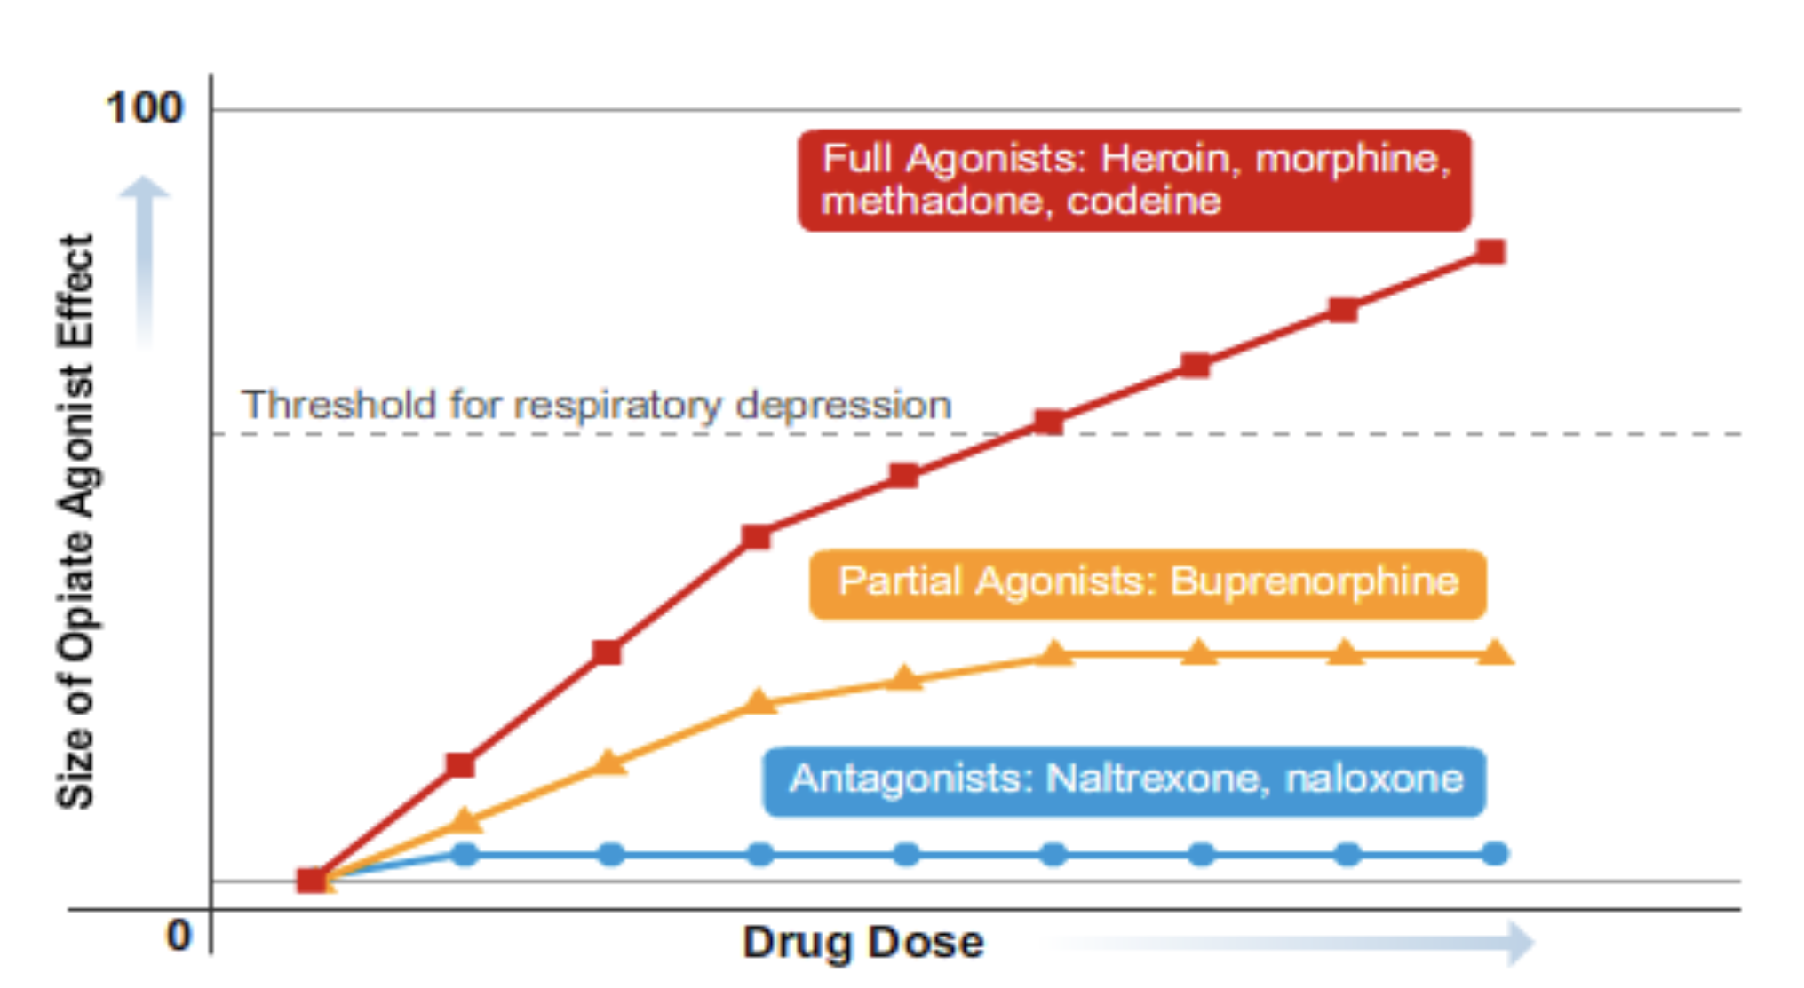
HOW SAFE IS BUPRENORPHINE?

Slide 33
DURATION OF ACTION OF SL
BUP/NAL
Rapid Onset 30-60 mins & peaks 1-4 hrs
Why is Naloxone in Bup/Nal?
-Prevents Diversion if Injected
as will cause withdrawal
-When taken SL Naloxone has no effect due to first past effect of liver
Steady State 3-7 days
Long Duration: Elimination half-life 24-36 hrs
Notes:
Kicks off all other opiates from receptor
Prevents other opiates from binding
Long lasting at high doses
Full Agonists: Methadone, Fentanyl morphine oxys🡪 cause euphoria, respiratory arrest & death

Slide 34
Mechanism Of Action Of Buprenorphine Naloxone
Partial MU Opiate Agonist
No Euphoric Effects
High Affinity for MU Receptor
No Respiratory Depression or Arrest
Slow dissociation from MU Receptor
Notes:
Kicks off all other opiates from receptor
Prevents other opiates from binding
Long lasting at high doses
Full Agonists: Methadone, Fentanyl morphine oxys🡪 cause euphoria, respiratory arrest & death

Slide 35
DURATION OF ACTION OF BUPRENORPHINE/NALOXONE
DURATION OF ACTION IS DOSE DEPENDENT
Dose | Duration of action
4-6 mg SL | 4-12 hours
8- 12mg SL | 24 hours
> 16 mg SL | 24-48 hours
Sublocade 300mg/100 mg (injection every 28 days) | 2-6 weeks up to months after steady state
Notes:
If give a dose of up to 24 mg in ER you can be potentially protecting them from OD for upto 3 days

Slide 36
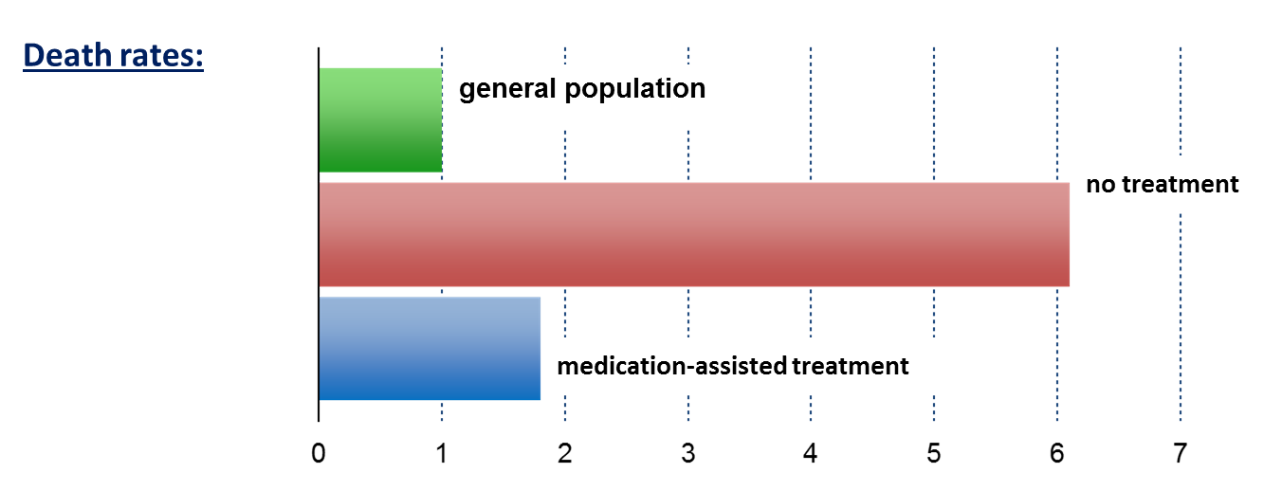
Benefits of MAT (aka OAT):Decreased Mortality
Standardized Mortality Ratio
Dupouy et al., 2017
Evans et al., 2015
Sordo et al., 2017
PCSS Waiver Training, 2019
http://pcssnow.org/medication-assited-treatment
Notes:
Speaker Notes:
Key Point #1: Patients out of treatment died at about 6 times the rate of people in the general population, while medication-assisted treatment with methadone brought this to less than 2 times.
Key Point #2: Retention in methadone and buprenorphine treatment is associated with substantial reductions in the risk for all cause and overdose mortality in people dependent on opioids.

Slide 37
BUPRENORPHINE/NALOXONE
Treats withdrawal symptoms
Helps with cravings
Protects patients from overdose and death

Slide 38
Opiate Withdrawal Symptoms
“Dope Sick”
Sweating
Anxiety and Irritability
Vomiting and Diarrhea
Myalgia and Arthralgia
Restlessness
Rhinitis and/or Tearing
Tremor
Yawning
Dilated Pupils

Slide 39
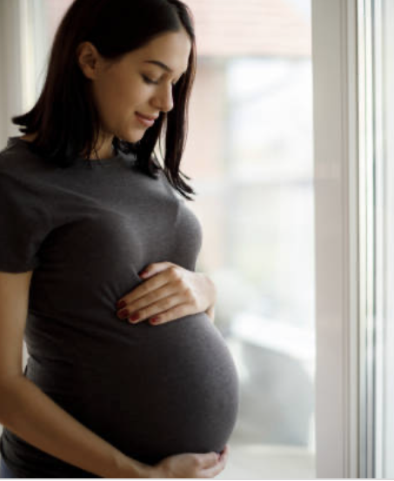
PREGNANCY AND SUBOXONE
IMPROVED OUTCOMES
Suboxone is safe in pregnancy
Longer gestation
Increased live birth rates
Greater birth weight
Earlier discharge of infants from hospital
Increase rate of infants remaining with mother,
Less HIV and Hep C transmission to baby

Slide 40
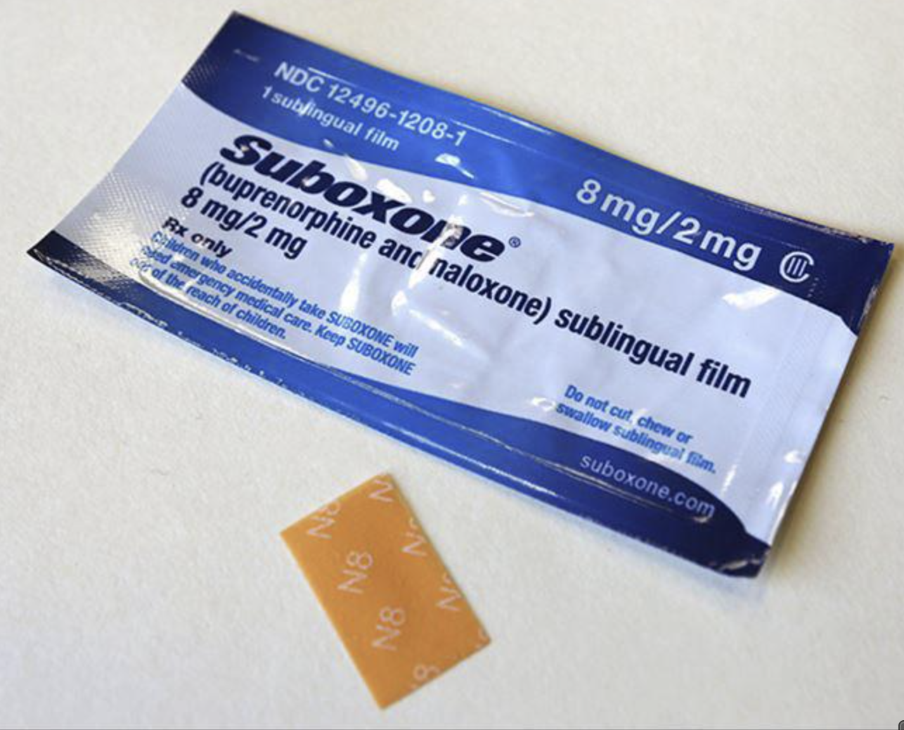
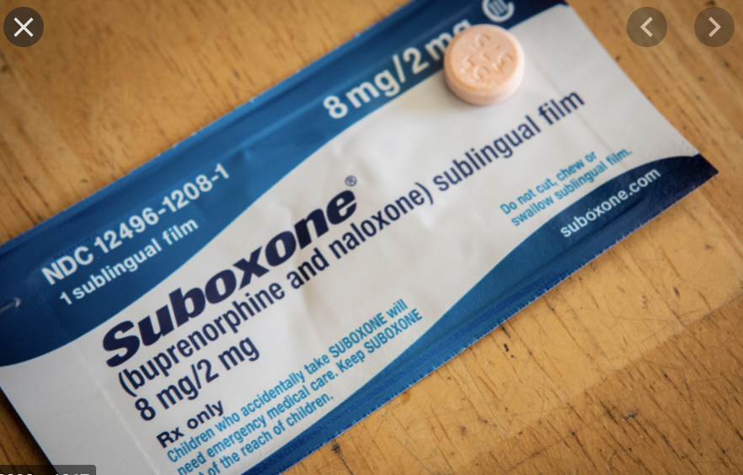
Forms of Buprenorphine/Suboxone
Picture of film and table

Slide 41
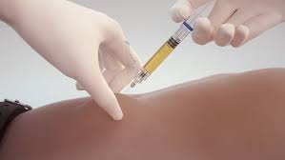
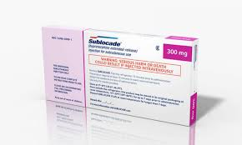
Forms of Buprenorphine
Injectable / Depot /Long Acting
Notes:
We are off label and give the injection earlier then 7 days in our detox beds- Day 3 or 4

Slide 42
Guidelines for Treating Opiate Addiction and Withdrawals with Suboxone/Sublocade

Slide 43
Treat when they present
=
Better outcomes

Slide 44
PRACTICE GUIDELINES FOR TREATMENT OF OUD
For Mod & Severe Withdrawals Bup/Nal offered WITHIN 2 HRS
HQO Opioid Use Disorder Quality Statements 2018
First Line Treatment Option for Withdrawals & OUD: BUP/NAL
Management of OUD: A National Clinical Practice Guideline (CMAJ 2018)
If Not in Withdrawals but Requesting Treatment: should be offered within MAX 3 DAYS (1st line BUP/NAL) HQO Opioid Use Disorder Quality Statements /18
If a person enters an inpatient facility, OAT should be continued without disruption HQO Opioid Use Disorder Quality Statements 2018
Notes:
We also found out about HQO benchmarks and practice guidelines that were developed 2018 that we were not following
The only place that can do this within 2 hours is ER- 24/7 and benchmarks

Slide 45
PRACTICE GUIDELINES FOR TREATMENT OF OUD
While on Treatment: Minimum 6 months of concurrent psychosocial treatment, support & monitor
Management of OUD: A National Clinical Practice Guideline (CMAJ 2018)
Withdrawal Management alone (“Cold Turkey”) will be avoided because it is associated with increased rates of relapse (60-90%), morbidity & death
Management of OUD: A National Clinical Practice Guideline (CMAJ 2018)
Discussion about Harm Reduction Strategies offered (Naloxone, clean drug paraphernalia, SCS, never use alone, smoking better than IV etc.) Management of OUD: A National Clinical Practice Guideline (CMAJ 2018)

Slide 46
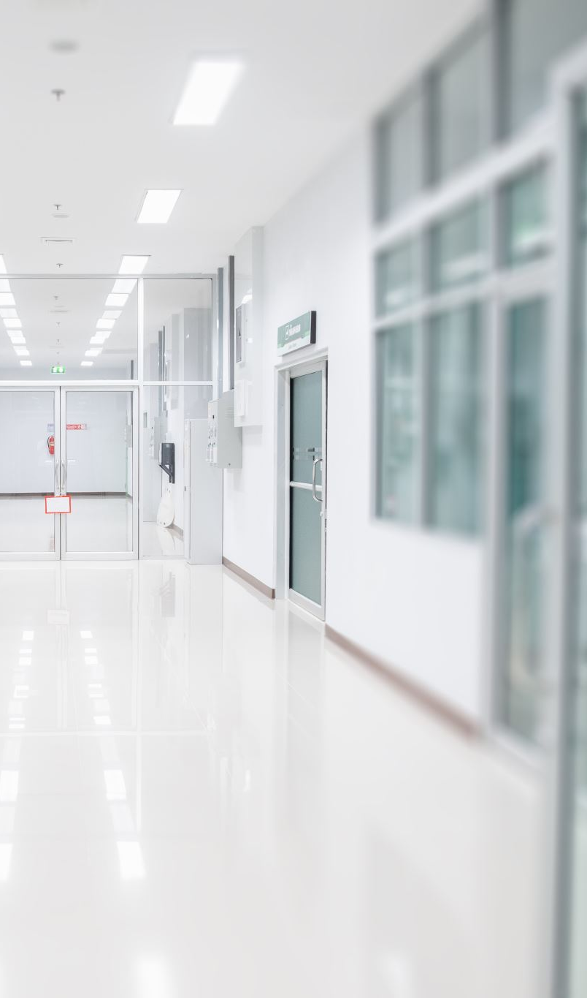
WHERE CAN WITHDRAWALS BE TREATED WITHIN 2 HOURS?
THE HOSPITAL

Slide 47
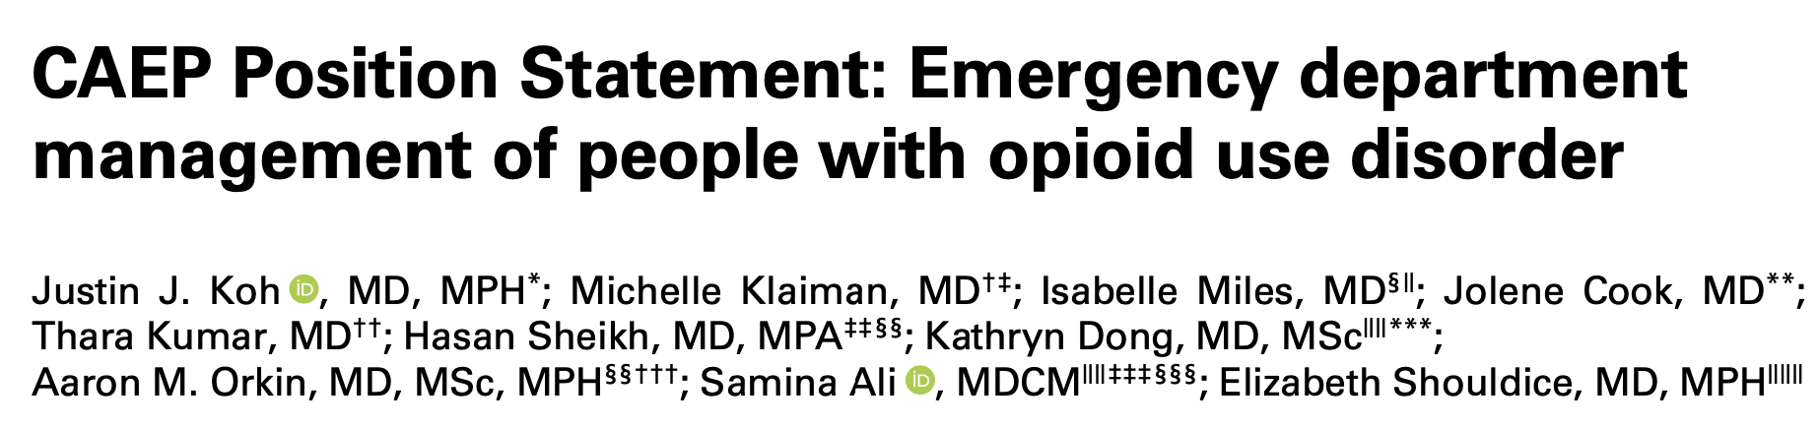
TREATING ADDICTIONS IN THE ER IS A STANDARD OF CARE
Expands opportunity for initiating treatment of OUD
Bup/Nal blocks craving & withdrawals symptoms
Bup/Nal prevents relapse & reduces OD & mortality
October 2020
Notes:
ER is a portal of access for pts suffering from addictions- it is open 24/7 and should be available to urgent care
Additions is an emergency- just as much as chest pains
The mortality rate is at it’s highest when spmeone leaves our ER after reversal with naloxone
Bup has been shown to tx sx and save lives

Slide 48
Changing the System:
Our Community’s Success Story (Solutions)
Timmins
Notes:
Timmins is located in northeastern Ontario on the Mattagami River
Population 41,788
Resource-based economy
Limited healthcare resources compared to densely populated Southern Ontario

Slide 49
Substance Use Disorder Treatment options
Medications
Acute treatment- withdrawal beds (in hospital)
Acute and Long Term Community Withdrawal Management services
Long Term Treatment programs ( 30 days - 1 year)
Day and evening programming
Land based program short and long term

Slide 50

BREAKING DOWN BARRIERS:
OUR INNOVATIVE APPROACH TO SYSTEM CHANGE
  BREAKING DOWN SILOS AMONGST COMMUNITY ORGANIZATIONS & IMPROVING PARTNERSHIPS
  OFFERING IMMEDIATE CARE AT HOSPITAL FOR THOSE REQUESTING TREATMENT FOR OUD
  SEAMLESS ACCESS TO THE FULL CONTINUUM OF ADDICTIONS TREATMENT
  DEVELOPING A PROGRAM TO MEET THE NEEDS OF OUR PATIENTS
Known as the whistleblowers
Notes:
Improved communication with community organizations
Emphasized the need to save lives
Asked numerous organizations for their support
“Called people out” for ineffective processes/care
Offered immediate care at hospital for those requesting treatment for OUD
Better access to treatment
Innovative approach, working outside our comfort zone
Developed a program to meet the needs of our patients
Many meetings: town hall, met with chief of police, City Council presentation, MAC , hospital board presentation, education day presentation. Education sessions with RN, ER docs, coastal communities..
SOLUTION: Coming together with community services
Immediate care at our hospital
Hospital stepped up to save lives – see slide 22
Interviews with local news

Slide 51
BREAKING DOWN BARRIERS: OCTOBER 2020
Town Hall Meeting
Task Teams
City Council
TADH Nursing Staff
MAC
TADH Board
ER physicians
Notes:
Town Hall Meeting
City Council presentation
MAC
TADH Board
ER physician
TADH Nursing staff
Development of Task Teams- 11 committees

Slide 52


INNOVATION AND IMAGINATION
AT THE HOSPITAL
HOSPITAL IS A KEY PLAYER
IN SYSTEM CHANGE
  FIRST CHANGING HOSPITAL CULTURE, REDUCING STIGMA, AND IMPROVING COMFORT LEVELS (including ED)
  PROVIDING IMMEDIATE TREATMENT FOR THOSE PRESENTING TO ER REQUESTING HELP
  OPENING OF MEDICAL WITHDRAWAL MANAGEMENT BEDS
  EDUCATION TO COLLEAGUES & STAFF
  IMPLEMENTING AMCS & CWMS TEAMS
  PROVIDING WRAPAROUND CARE
Notes:
Introduced sublingual buprenorphine-naloxone at the ED and home carry packs for patients (3 x 2 mg tablets per pack, may give 2 packs)
Hospital stepped up to save lives
Implemented medical withdrawal management beds
Hospital is a key player in system change
Opening of hospital medical withdrawal management beds
Team development and training
Pharmacy department involvement
Order sets and protocol development
Introduction of home carry packs for patients at the ED
Relentless education and discussion
Ensuring wraparound care
Improving comfort levels and hospital culture
Reducing stigma

Slide 53
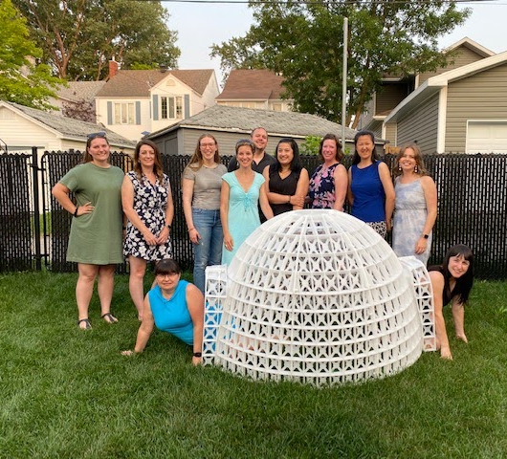
OUR TEAM
COMMUNITY WITHDRAWAL MANAGEMENT SERVICE
ACUTE MEDICINE CONSULT SERVICE
TIMMINS POLICE SERVICE COMMUNITY OUTREACH SAFETY PROGRAM
AND WE WORK VERY CLOSELY WITH MOBILE CRISIS

Slide 54
WITHDRAWAL MANAGEMENT BEDS
TIMMINS AND DISTRICT HOSPITAL
WiMU (Acute Withdrawal Management Unit) 12 BED UNIT LOCATED IN OUR HOSPITAL
  Initially started as 2 beds(Dec 2020) in the ICU
  STAFFED BY RNs
  AMCT RN AND HOSPITAL SW
PHYSICIAN ON CALL 7 DAYS A WEEK
OUTPATIENT COMMUNITY WITHDRAWAL MANAGEMENT SERVICES
RN
NP
SW
Notes:
Our CEO was on board and advocate for us and our patients
We presented to the MAC and the Board of TADH about the importance of these beds and having medical management of these pats available just like we do for any other medical emergency that presents to our hospital
If we sent them home from our ER dep without help… this increases their chances of death and possibly contributing the opiate related deaths in our city since we had a known treatment that we know makes a difference and saves lives
It also affects the hospital in so many ways
ER visit
Hospitalizations due to complications of drug use
Death rates in our community

Slide 55
GAME CHANGER #1: MACRODOSING, HERE WE COME!
MAXIMUM DAILY DOSING: 32 MG BUP/NAL
RAPID TITRATION WITH MACRODOSING BUP/NAL
  Sometimes higher during stabilization
  Day 1: COWS>12 + no fentanyl use >24 hrs
  Dosing: 24mg then 8 mg q1h prn X1
  Total dose over 1-2 hours= 32mg
** PEOPLE WHO USE FENTANYL**
Within 1-3 hours most patients are comfortable and feeling
no withdrawal symptoms
4.https://cabridge.ca
5.Mariani JJ et al. Am J addict.2021;1-7
6.Korownyk et al, Canadian Family Physician;2018:321-33
Notes:
Macrodosing is supported by recent clinical experience (met with Dr. Reuben Strayer, other investigators) and clinical evidence
Also supported by California bridge guidelines
Dr. Marion-Bellemare called Dr. Lee in the OR and they discussed ongoing studies
Dr. Lee: “Sounds like a good idea and makes sense pharmacologically but I haven’t actually done it myself” [paraphrased]
Protocols had to be changed for the benefit of patients
Listened to patients
Increased dose to 16/8/8 based on feedback from patients and nurses and now 24/8 mg
Dose in the first 24 h makes a big difference (dose > 32 mg may be needed)
Within 3 hours patients are comfortable, with some outliers
Now routinely use this macrodosing protocol
Percocet users: may use 6/16/8
There is literature support for higher and earlier dosing, including the California bridge guidelines
Discussed clinical experience with Dr. Reuben
Pharmacists resisted early BUP-XR injection, needed to be convinced it was lifesaving
Pharmacists worried about respiratory depression, but compared to the potency of fentanyl, this should not be an issue
Pharmacist worried about off label use with higher dosing… pts are using off label use of fentanyl on the streets—explain 1 point of fentanyl
Most patients are comfortable within 2-3 hours at 32 mg (some outliers)
Ativan or Valium can be used to alleviate symptoms for patients coming off of benzos – many patients do not know all drugs they are on
Timmins: do urine drug screens on all patients
London: fentanyl is contaminated with etizolam
Etizolam not detected in routine quick urine screen, need chromatography
Must give diazepam 10 mg/day for 3 days (Ken Lee approach)
Jacobs et al key points: Open-label, phase IV START trial showed higher doses associated with fewer dropout rates and no increase in AEs
740 patients in BUP arm studied
Max doses 16 mg on day 1, 32 mg on day 2-3
Carroll et al key points: Case series of 18 patients treated with high doses by EMS: All patients had improvement in symptoms and no signs of precipitated withdrawal; 16 mg initial dose, 24 mg max dose
Herring et al key points: Retrospective case series of 391 patients in an urban ED resulted in no respiratory depression or sedation.
Dose >12 mg (8-24 mg per dose)
5 cases of PW (0.8%) were not associated with dose
Ken Lee: Benzos in first 3 days

Slide 56
GAME CHANGER #2: EARLY DEPOT-BUP HERE WE COME!
MAXIMUM DAILY DOSING: 32 MG BUP/NAL
RAPID TITRATION WITH MACRODOSING BUP/NAL
  Sometimes higher during stabilization
  Day 1: COWS>12 + no fentanyl use >24 hrs
  Dosing: 24mg then 8 mg q1h prn X1
  Total dose over 1-2 hours= 32mg
24-72 hours after first sublingual buprenorphine-naloxone dose
EARLY DEPO-BUPRENORPHINE
** PEOPLE WHO USE FENTANYL**
Within 1-2 days patients receive depot-bup
no withdrawal symptoms
4.https://cabridge.ca
5.Mariani JJ et al. Am J addict.2021;1-7
6.Korownyk et al, Canadian Family Physician;2018:321-33
Notes:
Macrodosing is supported by recent clinical experience (met with Dr. Reuben Strayer, other investigators) and clinical evidence
Also supported by California bridge guidelines
Dr. Marion-Bellemare called Dr. Lee in the OR and they discussed ongoing studies
Dr. Lee: “Sounds like a good idea and makes sense pharmacologically but I haven’t actually done it myself” [paraphrased]
Protocols had to be changed for the benefit of patients
Listened to patients
Increased dose to 16/8/8 based on feedback from patients and nurses
Dose in the first 24 h makes a big difference (dose > 32 mg may be needed)
Within 3 hours patients are comfortable, with some outliers
Now routinely use this macrodosing protocol
Percocet users: may use 6/16/8
There is literature support for higher and earlier dosing, including the California bridge guidelines
Discussed clinical experience with Dr. Reuben
Pharmacists resisted early BUP-XR injection, needed to be convinced it was lifesaving
Pharmacists worried about respiratory depression, but compared to the potency of fentanyl, this should not be an issue
Pharmacist worried about off label use with higher dosing… pts are using off label use of fentanyl on the streets—explain 1 point of fentanyl
Most patients are comfortable within 3 hours at 32 mg (some outliers)
Ativan or Valium can be used to alleviate symptoms for patients coming off of benzos – many patients do not know all drugs they are on
Timmins: do urine drug screens on all patients
London: fentanyl is contaminated with etizolam
Etizolam not detected in routine quick urine screen, need chromatography
Must give diazepam 10 mg/day for 3 days (Ken Lee approach)
Jacobs et al key points: Open-label, phase IV START trial showed higher doses associated with fewer dropout rates and no increase in AEs
740 patients in BUP arm studied
Max doses 16 mg on day 1, 32 mg on day 2-3
Carroll et al key points: Case series of 18 patients treated with high doses by EMS: All patients had improvement in symptoms and no signs of precipitated withdrawal; 16 mg initial dose, 24 mg max dose
Herring et al key points: Retrospective case series of 391 patients in an urban ED resulted in no respiratory depression or sedation.
Dose >12 mg (8-24 mg per dose)
5 cases of PW (0.8%) were not associated with dose
Ken Lee: Benzos in first 3 days

Slide 57
GAME CHANGER #3: STRAIGHT UP DEPOT-BUP HERE WE COME!
Depo buprenorphine dose at anytime after fentanyl use (may require SL bup-nal if nearing 24 hrs after fentanyl use due to length of time of effectiveness of Depo-Bup)
EARLY DEPO-BUPRENORPHINE
** PEOPLE WHO USE FENTANYL**
Patients receive depot-bup no withdrawal symptoms
Notes:
Macrodosing is supported by recent clinical experience (met with Dr. Reuben Strayer, other investigators) and clinical evidence
Also supported by California bridge guidelines
Dr. Marion-Bellemare called Dr. Lee in the OR and they discussed ongoing studies
Dr. Lee: “Sounds like a good idea and makes sense pharmacologically but I haven’t actually done it myself” [paraphrased]
Protocols had to be changed for the benefit of patients
Listened to patients
Increased dose to 16/8/8 based on feedback from patients and nurses
Dose in the first 24 h makes a big difference (dose > 32 mg may be needed)
Within 3 hours patients are comfortable, with some outliers
Now routinely use this macrodosing protocol
Percocet users: may use 6/16/8
There is literature support for higher and earlier dosing, including the California bridge guidelines
Discussed clinical experience with Dr. Reuben
Pharmacists resisted early BUP-XR injection, needed to be convinced it was lifesaving
Pharmacists worried about respiratory depression, but compared to the potency of fentanyl, this should not be an issue
Pharmacist worried about off label use with higher dosing… pts are using off label use of fentanyl on the streets—explain 1 point of fentanyl
Most patients are comfortable within 3 hours at 32 mg (some outliers)
Ativan or Valium can be used to alleviate symptoms for patients coming off of benzos – many patients do not know all drugs they are on
Timmins: do urine drug screens on all patients
London: fentanyl is contaminated with etizolam
Etizolam not detected in routine quick urine screen, need chromatography
Must give diazepam 10 mg/day for 3 days (Ken Lee approach)
Jacobs et al key points: Open-label, phase IV START trial showed higher doses associated with fewer dropout rates and no increase in AEs
740 patients in BUP arm studied
Max doses 16 mg on day 1, 32 mg on day 2-3
Carroll et al key points: Case series of 18 patients treated with high doses by EMS: All patients had improvement in symptoms and no signs of precipitated withdrawal; 16 mg initial dose, 24 mg max dose
Herring et al key points: Retrospective case series of 391 patients in an urban ED resulted in no respiratory depression or sedation.
Dose >12 mg (8-24 mg per dose)
5 cases of PW (0.8%) were not associated with dose
Ken Lee: Benzos in first 3 days

Slide 58
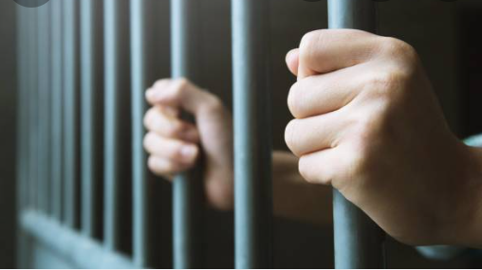
WHERE CAN WITHDRAWALS BE TREATED WITHIN 2 HOURS?
JAIL CELLS
and…….

Slide 59
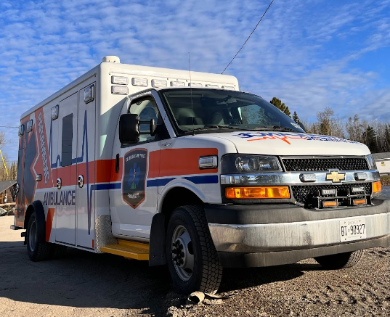

SUBOXONE IN THE FIELD
Notes:
That’s when Seamus became our main ally

Slide 60
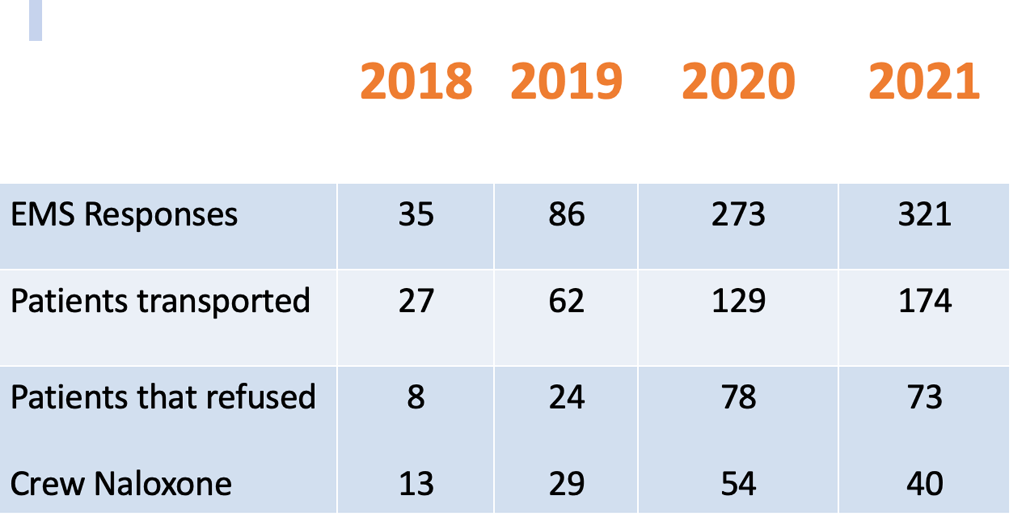
CDPS Opiate Poisoning Calls
Notes:
2020 Percentage not transported = 29%
2021 Percentage not transported = 23%
2022 Percentage not transported = 39%
2023 Percentage not transported = 37%

Slide 61

BRING TREATMENT TO THE PATIENT
Notes:
We were missing out on pts in the field

Slide 62

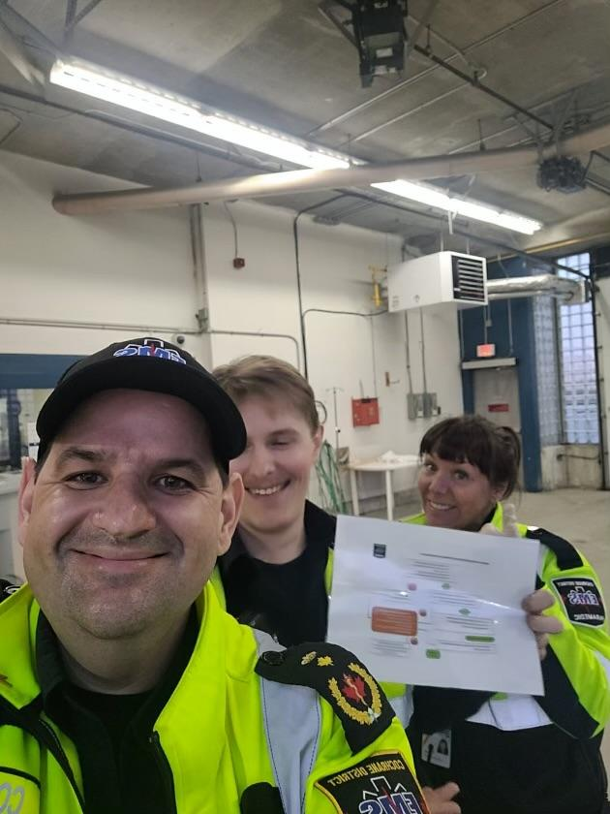
Opioid Crisis and Buprenorphine/Naloxone Pilot
Start Date: May 1st, 2023

Slide 63
WHY OFFER TREATMENT IN THE CELLS AND IN THE FIELD
IMMEDIATE ACCESS TO EVIDENCED BASED LIFE SAVING TREATMENT
PORTAL OF ENTRY/ ACCESS FOR ADDICTION TREATMENT/HEALTH CARE
PT MAY REMAIN IN TREATMENT AFTER INITIATION IN EMS CARE
WELL KNOWN LONG TERM BENEFITS IF THEY DO REMAIN IN TREATMENT
DECREASE IN EMS CALLS
LARGE PERCENTAGE OF REFUSAL OF HOSPITAL TRANSPORT (~25%)
IMPROVED JOB SATISFACTION
DECREASED COMPASSION FATIGUE
THEY CAN’T REMAIN IN TREATMENT IF THEY ARE NOT OFFERED TREATMENT

Slide 64
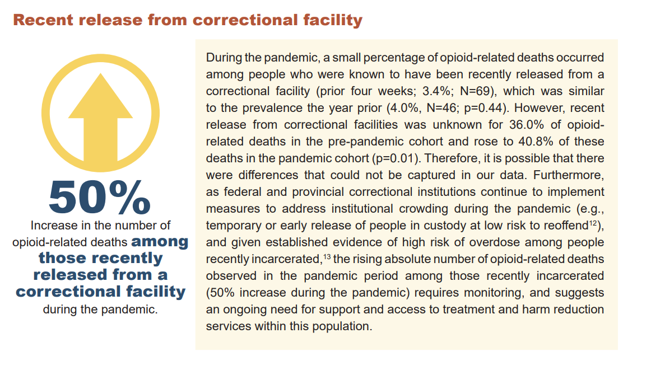

IMPROVING ACCESS TO TREATMENT IN CORRECTIONS

Slide 65
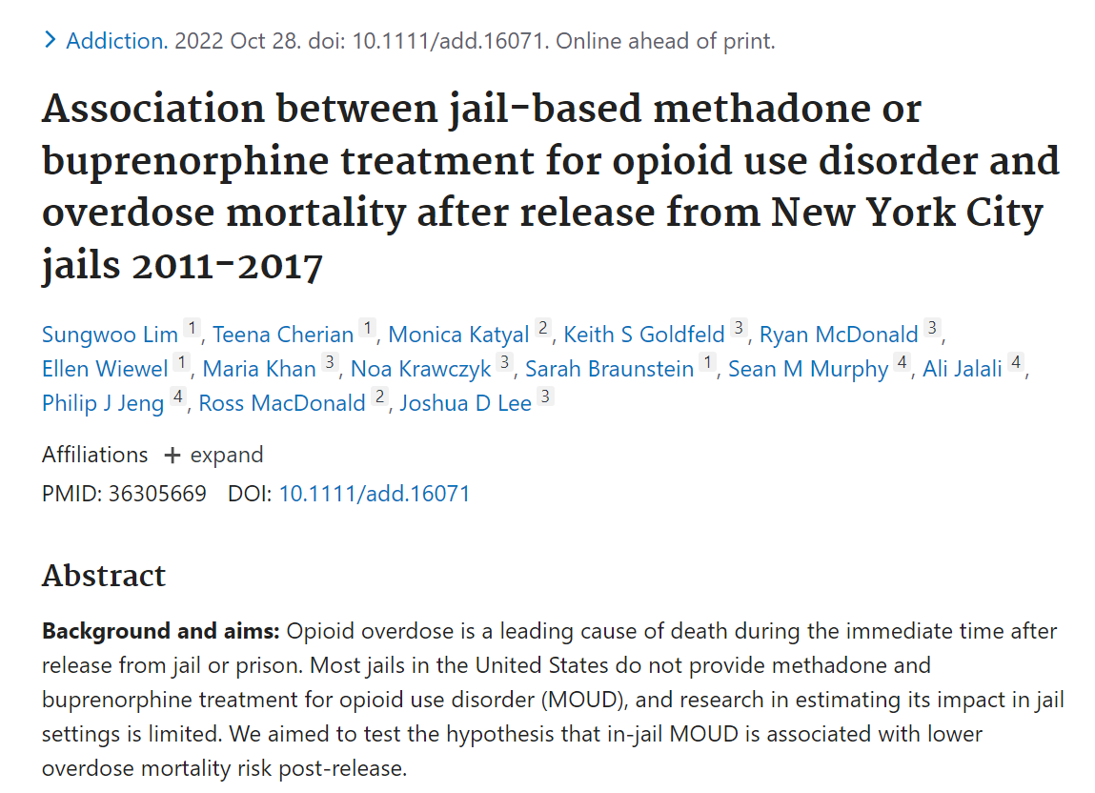
"Methadone and buprenorphine treatment for opioid use disorder during incarceration was associated with an 80% reduction in overdose mortality risk for the first month post-release."

Slide 66
FUTURE: ASSESS OUR SUCCESS
Retrospective Chart Review
  In collaboration with Women’s College Hospital Toronto ON
    Treatment retention
    Health care utilization pre and post introduction of our programs at TADH
    OD’s rates
Continuation of our flexible re-entry program

Slide 67
Addictions Programming and Treatment
Should never be punitive programming → everyone’s pathway through the continuum of care looks different & will revisit different components as needed→ we must be available to support when they ask for support
No matter where someone enters the system (be it high school, police custody, homeless shelter, doctors office/clinic, hospital )→ access to support will be immediate including income security, food and shelter

Slide 68
SAFE HEALTH SITE TIMMINS-- SHST
OVERDOSE PREVENTION SITE
SAFE INJECTION SITE
SAFE CONSUMPTION SITE

Slide 69
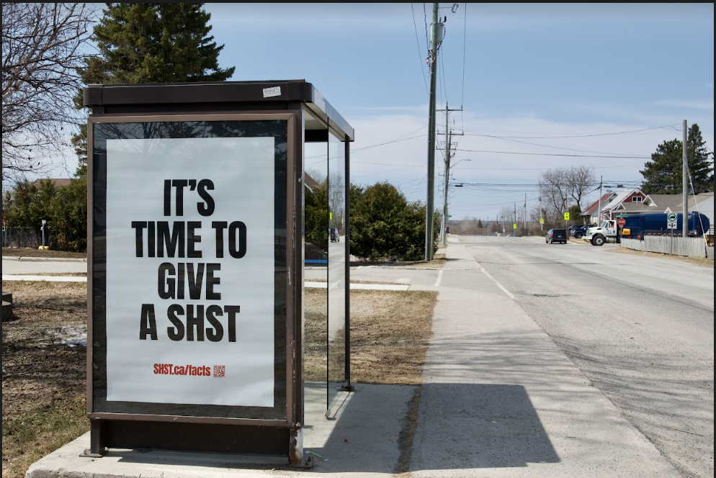
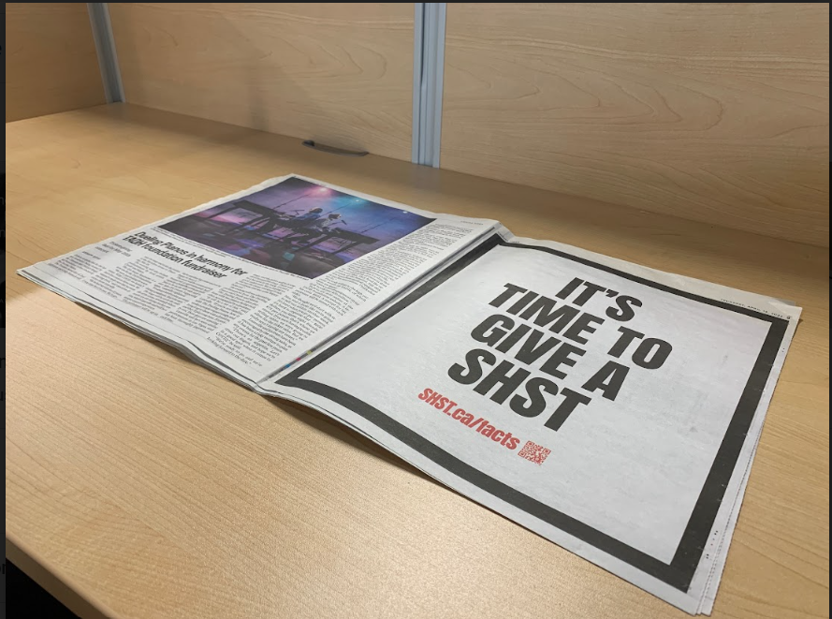

Slide 70
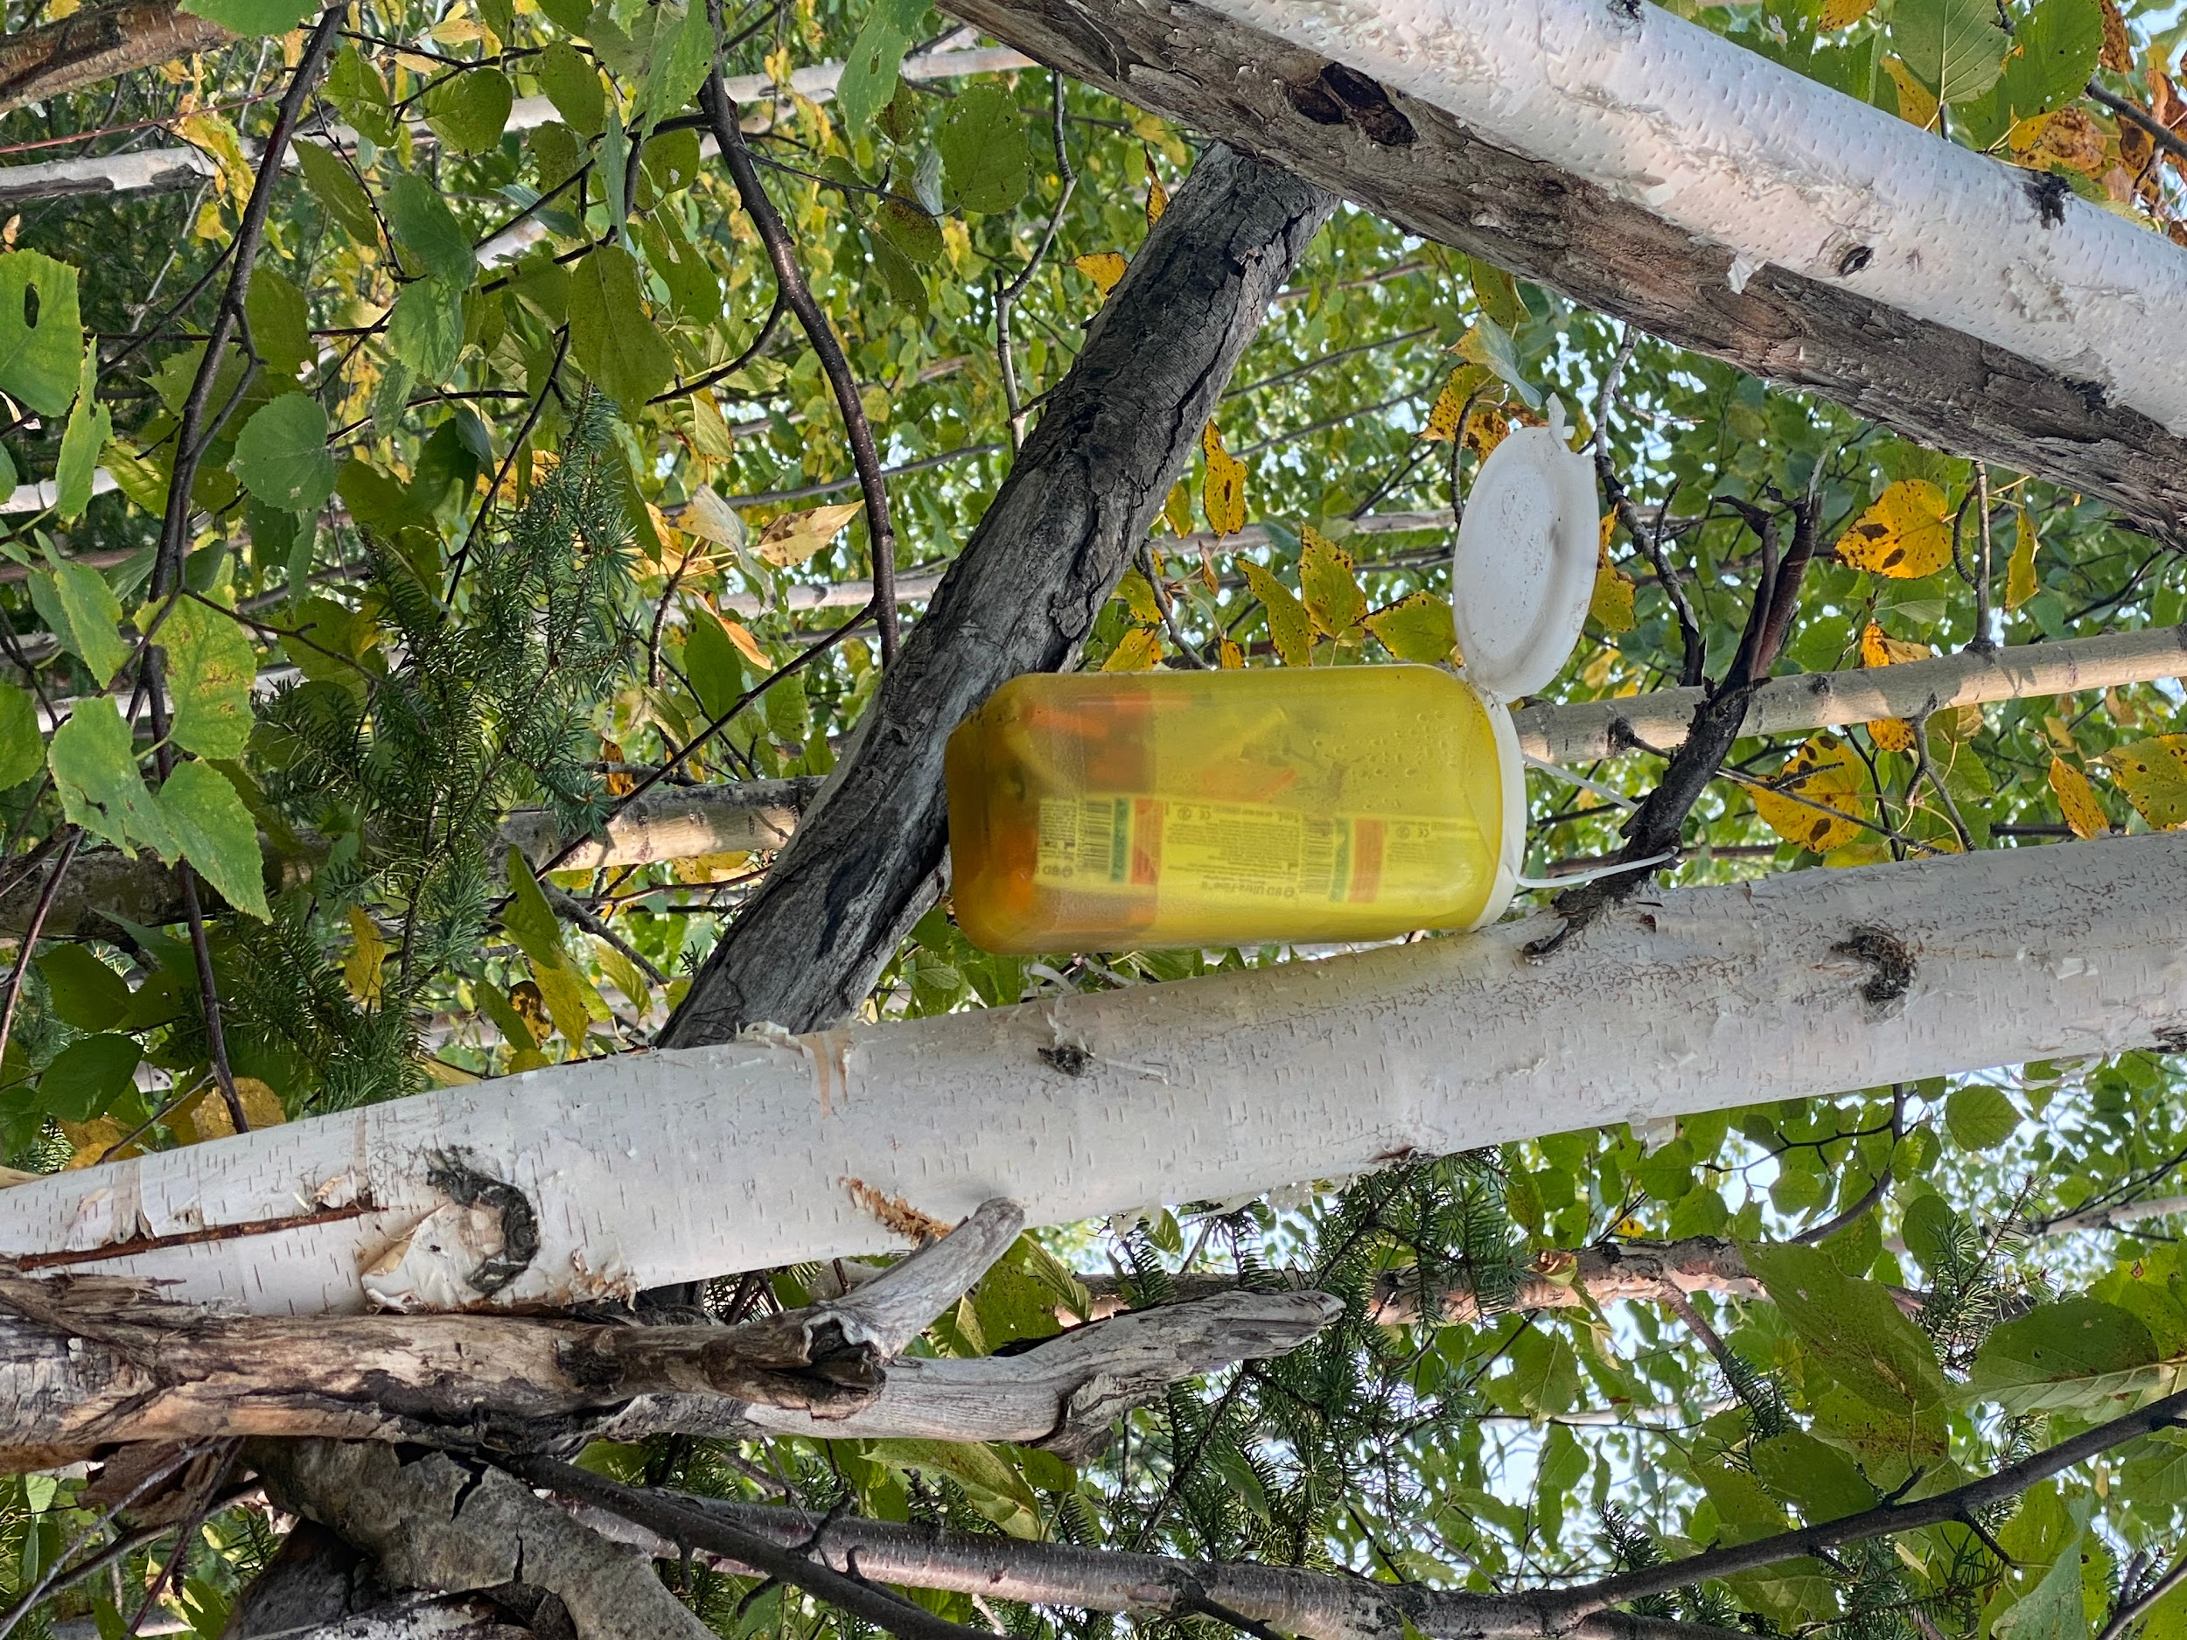

TIMMINS PREVIOUS SAFE CONSUMPTION SITE

Slide 71
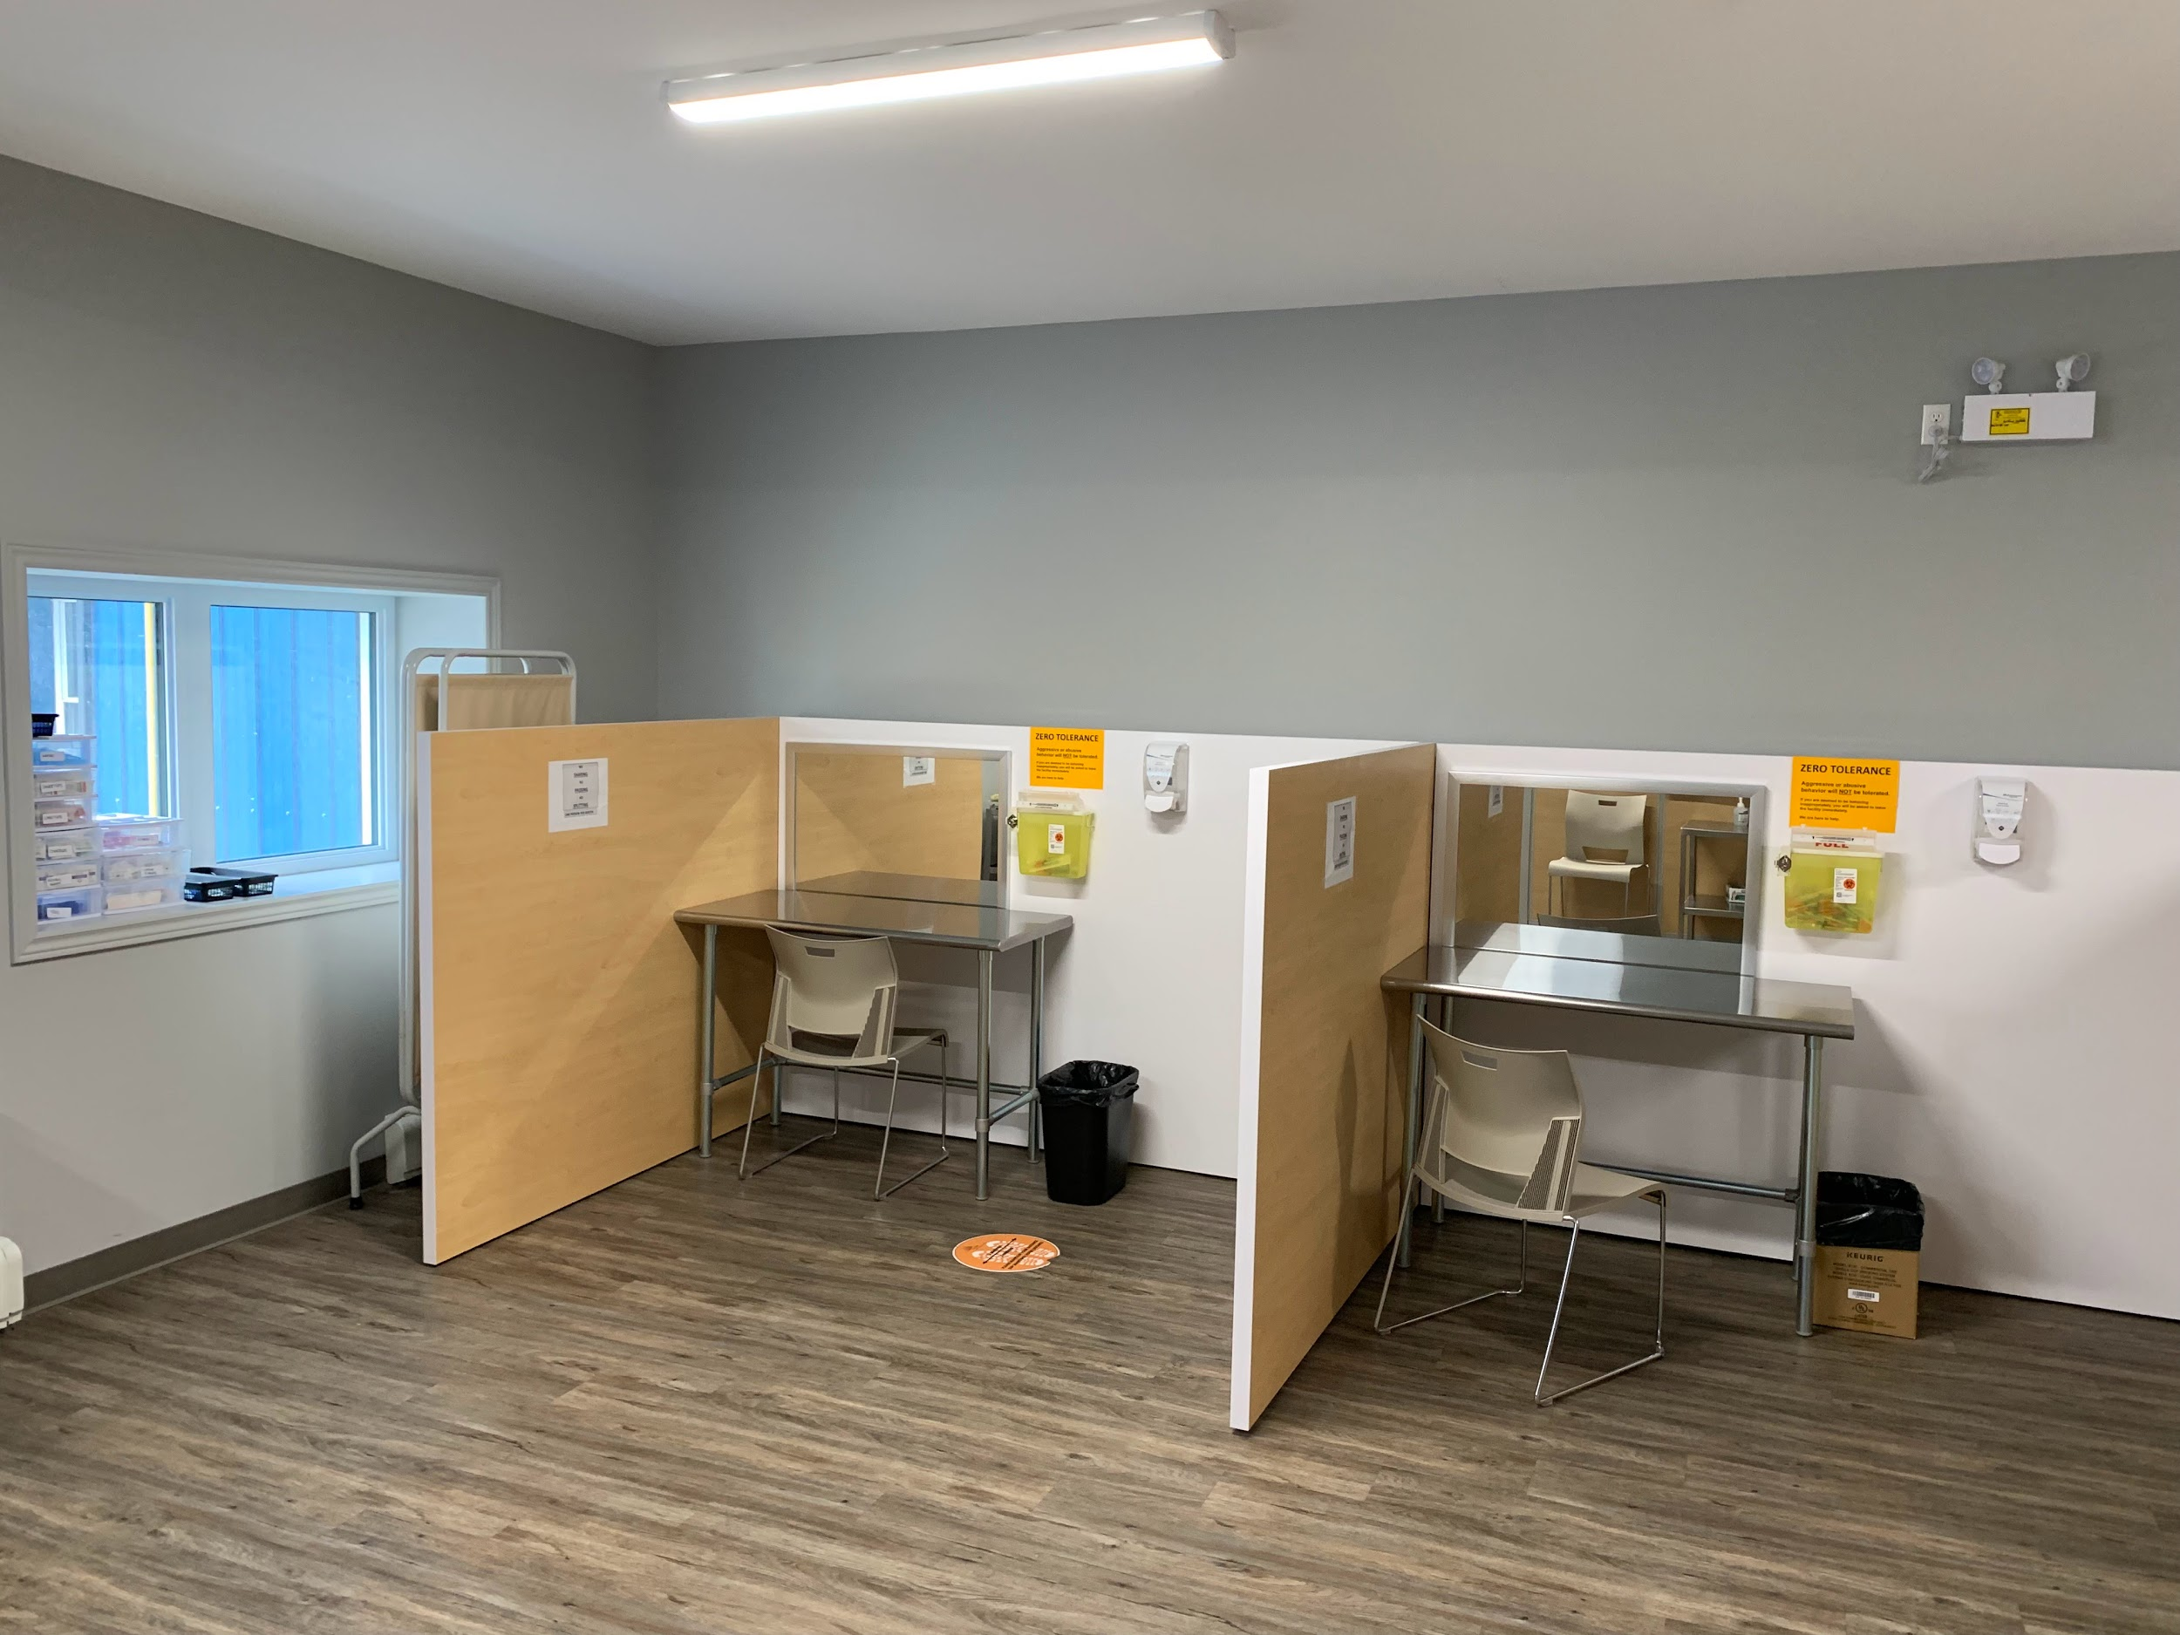
SAFE HEALTH SITE TIMMINS (SHST)
(OVERDOSE PREVENTION SITE)

Slide 72
It takes a community
Naloxone distribution
Naloxone distribution sites
Supply distribution
Harm reduction health education
Supervised consumption sites
Partnerships with addiction organizations
Medical withdrawal management beds at TADH
RAAM
Harm Reduction
Emergency Management
Treatment
Opioid emergency response task force
Anti-stigma
Social Determinants Of Health
Supporting Families
Housing
Policy
Enforcement
Prevention
Partnerships
Mobile Crisis
Stigma ▪ Trauma Informed Care ▪ Lived Experience
Notes:
SHST is a collaborative approach between many different agencies and communities.
SHST is a small part in a larger drug strategy that includes prevention, treatment, and addressing social determinants of health.

Slide 73
OVERDOSE PREVENTION SITES
WHAT ARE THEY?
Legally sanctioned and supervised facilities designed to reduce the health and public order problems associated with illegal injection drug use
Enable the consumption of pre-obtained drugs in an anxiety and stress-free atmosphere, under hygienic and low risk conditions
Notes:
EUROPE:
First established in Europe in the 1970s
45 SISs currently operating there with the majority located in the Netherlands, Switzerland and Germany
CANADA
VANCOUVER since 2003: Insite clinic and Dr.Peter Centre
ONTARIO: 21 sites approved by Liberal Gvt, 15 sites in operation
NORTHEASTERN ONTARIO: Sudbury is in the process of application

Slide 74
OVERDOSE PREVENTION SITES
GOALS;
Reduce public disorder and enhance public safety
Reduce overdose morbidity and mortality
Reduce transmission of blood- borne infections
Improve access to other health and social services
Notes:
1: reduced discarded “gear” (needles, wrappers, syringes, tie-offs, cooking paraphernalia
EMS calls and police calls to people who use drugs in public places and overdoses
2. Morbidity: include infections : cellulitis, endocarditis, abscesses etc
3. HIV, Hep C
4. Treatment programs: WM, Detox, OAT, housing, counseling, income, disability, mental health

Slide 75
WHAT ARE OUR BIASES ?
Promotes and enables people to use IV drugs
Causes disruption in the neighbourhood/community
Increase in crime rates in area surrounding the SIS
Not in my backyard mentality
It’s their decision to do drugs...why should we enable them and allow them to continue to do so
Notes:
We are all entitled to our opinions but the facts are the facts and here is the evidence

Slide 76
WHAT’S THE EVIDENCE?
SIS SAVES LIVES!!
DECREASE IN OVERDOSE FATALITIES
DECREASE IN HIV AND HEP C RATES
LESS INJECTION RELATED INFECTIONS
LESS ER VISITS
LESS HOSPITALIZATIONS
LESS AMBULANCE CALLS
Notes:
Most overdoses deaths occur when people are injecting alone at home
creation of Insite, the rate of fatal overdose within 500m of the facility decreased by 35 percent (Marshall et al. 2011, 1433)
Reduced overdoser related fatalities in vancouver and europe in communities where SIS are present
Reduce overdose-linked hospitalizations by a factor of ten (Wright and Tompkins 2004)
CONTROVERSIES
Promotes and enables people to use IV drugs
Causes disruption in the neighbourhood/community
Increase in crime rates in area surrounding the SIS
Not in my backyard mentality
It’s their decision to do drugs...why should we enable them and allow them to continue to do so

Slide 77
EVIDENCE
REDUCTION ON OVERDOSE RELATED DEATHS
Proven in Insite study and Europe studies
Decreased by 35% (Marshall et al. 2011, 1433)
Notes:
Most overdoses deaths occur when people are injecting alone at home
creation of Insite, the rate of fatal overdose within 500m of the facility decreased by 35 percent (Marshall et al. 2011, 1433)
Reduced overdoser related fatalities in vancouver and europe in communities where SIS are present

Slide 78
EVIDENCE
HARM REDUCTION
Insite Clinic in Vancouver
75% reported a change in their injecting behaviour (1)
23% had stopped injecting by the end of the study period (2)
57% had entered addiction treatment (2)
30% of clients reported using detoxification services (3)
1,Bayoumi et al. St.Michael’s Hospital 2012
3.DeBeck et al, Drug and Alcohol Dep.. 2011;113(2):172-6
2.Petrar S et al. Addictive Behaviours 2007;32(5):1088-93
Notes:
Injection behaviour:
Unsafe injection practices, needle sharing, and the use of non-sterile equipment
1.1082 IDU surveyed fewer public injections and 56% reported less unsafe needle disposal (5)
2. 3 year study 2003-2006
Decrease in morbidity
-cellulitis,
-injection site related abscesses
-endocarditis
-epidural abscesses
Can also translates into less hospitalizations and ER visits
Retention to tx program- seems to range from
1.Bayoumi AM, Strike C. Report of the Toronto and Ottawa supervised consumption assessment study, 2012: St. Michael's Hospital; 2012
2.Petrar S, Kerr T, Tyndall MW, Zhang R, Montaner JS, Wood E. Injection drug users' perceptions regarding use of a medically supervised safer injecting facility. Addictive behav- iors. 2007;32(5):1088-93
3.,DeBeck K, Kerr T, Bird L, Zhang R, Marsh D, Tyndall M, et al. Injection drug use cessation and use of North America's first medically supervised safer injecting facility. Drug and alcohol dependence. 2011;113(2):172-6.

Slide 79
Safe Health Site Timmins
Saves lives^{2, 5, 13, 19}
Lowers the risk of infection and other medical issues ^{20, 21, 22, 25}
Connects people to services^{14, 19, 20, 23}
Provide practical benefits
Helps reduce number of people using in public spaces^{8, 9, 10, 24}
Helps reduce discarded litter^{8, 9, 10, 24}
Saves resources
Opened July 4, 2022
Notes:
1. Supervised consumption sites are a medical intervention that addresses a health issue – addiction and the harms associated with substance use
They are a safe, controlled environment for people to use their own, pre-obtained substances in the presence of trained medical staff who can recognize and respond to adverse reactions, including overdoses (20)
These sites provide an alternative for people who use alone – remember this is a major known contributor to opioid related deaths.
Individuals are provided with a range of sterile harm reduction supplies, education on safer consumption practices.
These sites also provide basic needs that, like bathrooms, a safe place and most importantly, facilitates contact with other health and social services.
2. Supervised consumption sites have Many different names. The name usually coincide with their permanency, services required, title of application and which government the application is going to etc..
Sometimes known as Overdose prevention sites, safe injection services, supervised consumption services, urgent public health needs sites, Consumption treatment services, supervised injection sites, etc.. We tend to use Supervised consumption site as a general term to describe any these types of sites. The actual application for our site is under an Urgent Public Health Need site application. This application is for a time-limited site (temporary).
The overarching principles remain the same, no matter what the name is:
A place where someone who use substances can go to be observed by a medical professional so that they can intervene and prevent an overdose death.
2. To operate a sit, you must receive an exemption under section 56 of the Controlled Drugs and Substances Act from the federal government. This exemption is what allows a site to legally operate in Canada, because this exemption allows for legal protection from simple drug possession. The exemption is only for a very specific location (i.e. first floor of a specific building).
3. The individuals participating in these sites often experience many barriers to accessing health-related services. SCS allow for engagement and connection to other services, including treatment services, housing services, ect..

Slide 80
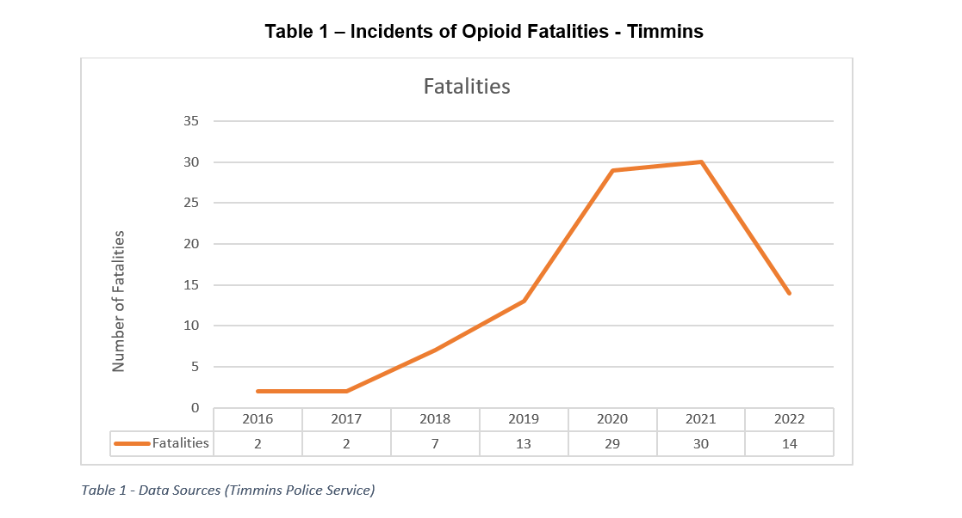

Slide 81
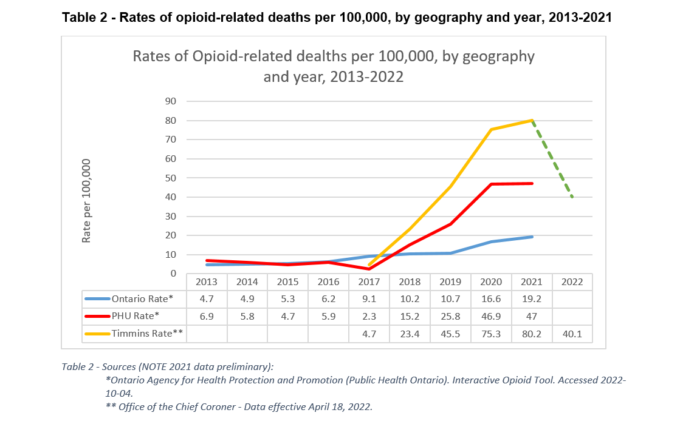

Slide 82
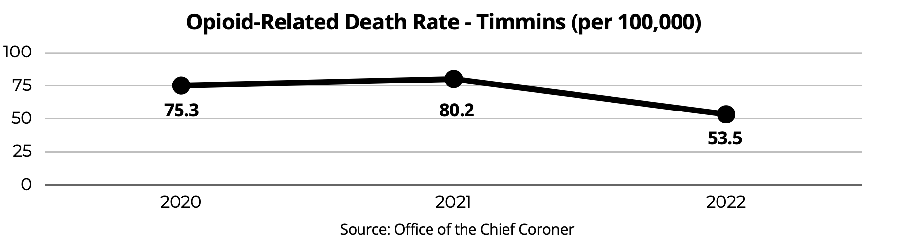
OPIATE RELATED DEATHS IN TIMMINS

Slide 84
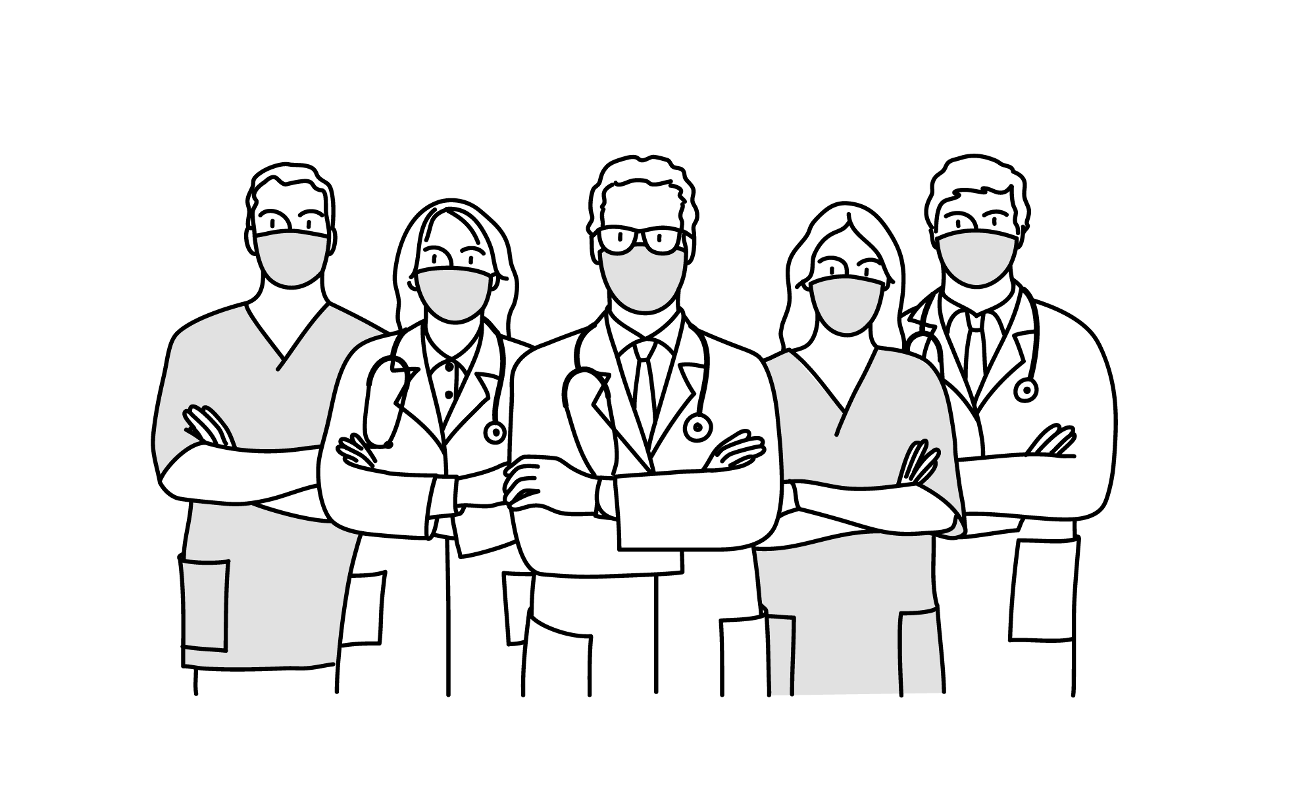
REFLECTION ON PAST AND PRESENT SUCCESSES
We haven’t seen J.S. in a long time in emerg.
-RN ER & physician
What did we do before? We were letting these patients down.
-RN ICU and physicians
We no longer send people home if our beds are “full”
RN ER & physician
This is AMAZING, the change we are making for these patients.
-RN ICU

Slide 85



REFLECTION ON PAST AND PRESENT SUCCESSES
I have never felt
this good...
-Patient
I was using 1 g of fentanyl a day 48 hours ago and now I have no cravings and no withdrawals...
I thought it would be impossible.
-Patient
My friend was here 2 months ago and is still not using drugs… I need to get on “the needle”
-Patient

Slide 86
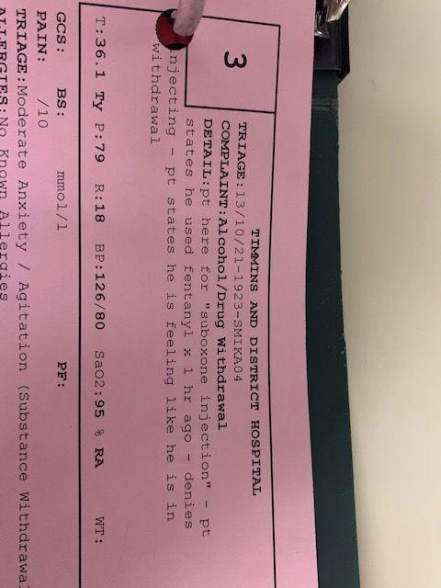
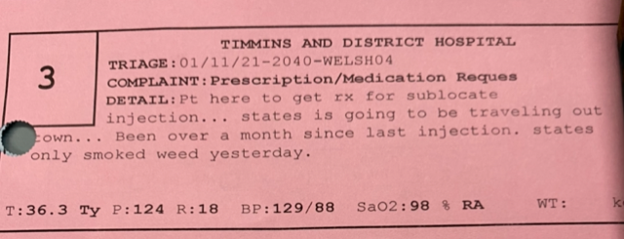

Slide 87
QUESTIONS?

