Slide 1
Restorative Justice
Presenter:
Jennifer J. McKenzie
Restorative Justice Coordinator
Nokiiwin Tribal Council

Slide 2
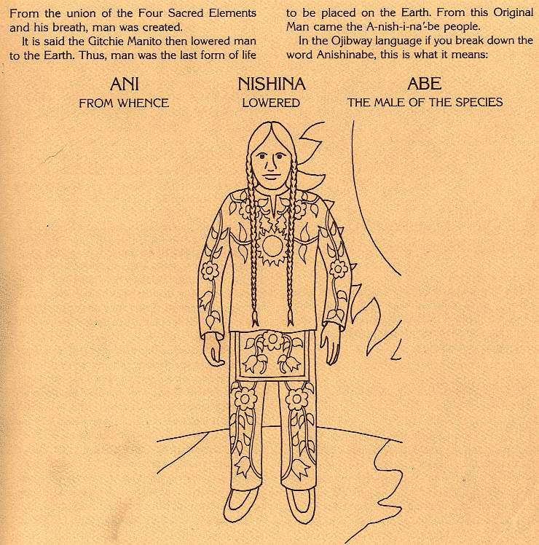

Slide 3
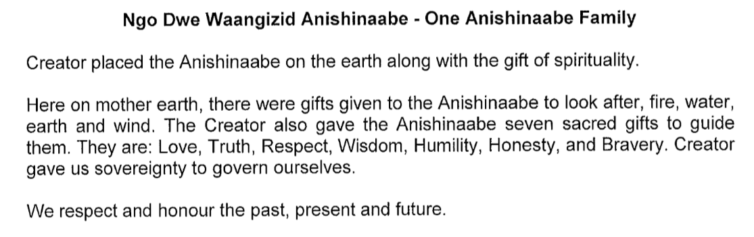

Slide 5
The highest wisdom of all is the wisdom of love (Zaagidwin), compassion for all regardless of whether others feel it is deserved or not. It is the wisdom of love that both protects, heals, and provides safe space for victims as well as brings the possibility of restoration for those who have caused harm; because the wisdom of love also knows that those who have hurt others have also first been victims.

Slide 6
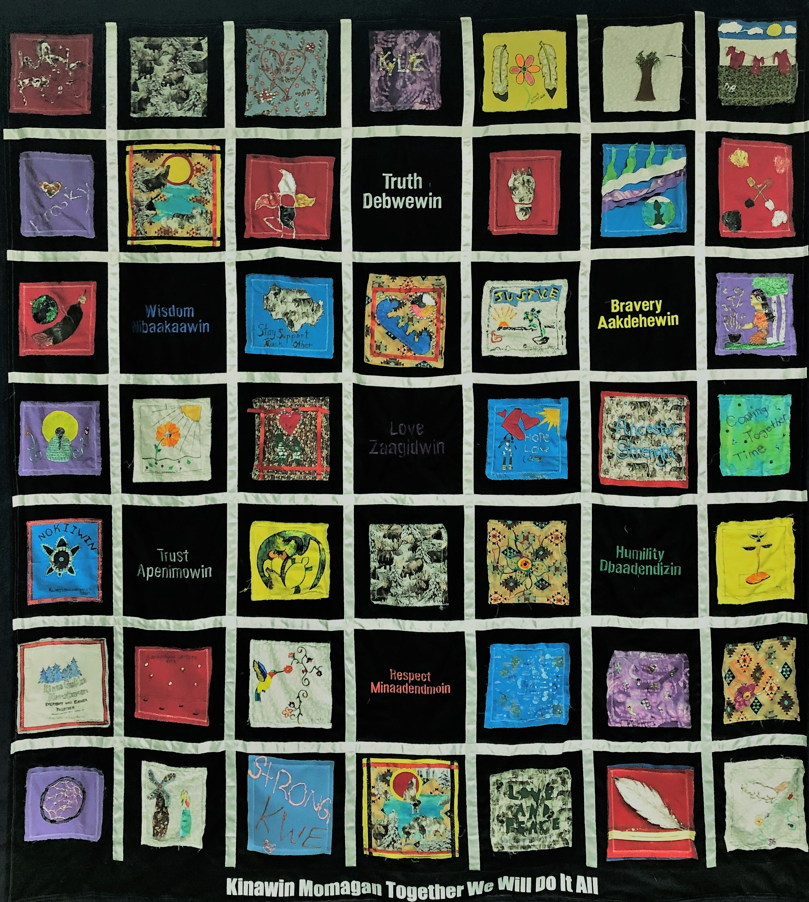
“Indigenous legal traditions are like a quilt. It is us that have threads of knowledge. We have to start to put them together.”
- Elder Marlene Pierre, Fort William First Nation

Slide 7
What is Restorative Justice?
Just outcomes for all not only for the person harmed but for the person who has harmed, family, friends, community that are affected.
Acknowledges that it is important to restore relationships between individuals and to restore individual(s) back into the community.
The aim is to move forward from what happened in a positive and healing direction.

Slide 8
Whenever we do something good, you can call that restorative justice because we are reclaiming and practicing what is right and what Creator gave us in the teachings.
– Elder Marlene Pierre, Fort William First Nation

Slide 9
Emphasis is on our need for humility (Dibaadendziiwin) in moving forward – the humility to know that, although we are all an important and sacred part of the whole, we are only a part, equal to others, but in no way better than the individuals and communities that we serve. It is this sort of humility that challenges us to become more inclusive, respectfully cooperating with all involved.

Slide 10
Punishment
The focuses on blame, guilt, and punishment. Focus on how “bad” a person is.
The individual(s), group, community affected are often overlooked and not heard. Those who caused harm are not given the opportunity to take responsibility or to learn from their actions.

Slide 11
Comparison of punishment and restorative justice circles
Often does not learn from their actions
Promotes silence
Separation between individuals without meaningful resolution
Spaces are not any safer
No opportunity to share events or experiences that have influenced behaviours
Minimal or no interaction or community involvement
Accepts responsibility & learns from their actions
Promotes openness – all affected parties can talk about what happened
Promotes safer spaces
Circle is a safe place and provides an opportunity for individuals to share their feelings, thoughts, experiences
Greater involvement with all affected
Opportunity for Elder involvement
Acknowledge individual’s giftings, potential
Helps us to address intergenerational traumas & a catalyst for personal healing

Slide 12
It takes bravery (Aakdehewin), the courage to face the challenges before us with integrity, with a strong and fearless heart, to face the situation as it is.

Slide 13
Equality
Equal
  Everyone has equal seating
  No start, no finish
  Safety and trust – everyone can see one another
  Inclusion and responsibility – everyone has a chance to participate and to be heard
  Connection with one another
  Community involvement – brings community together instead of pulling them apart
  Wholeness

Slide 14
In the circle, we are truth (Debwewin) tellers, we speak our truths. Our elders encourage young people to become not only hearers and speakers of truth, but to become people of integrity, deceiving neither themselves nor others as they grow in the wisdom of our ways.

Slide 15
We are encouraged to walk in honesty (Gwekwaadziwin) of both word and action, to speak honestly about both ourselves and our communities

Slide 16
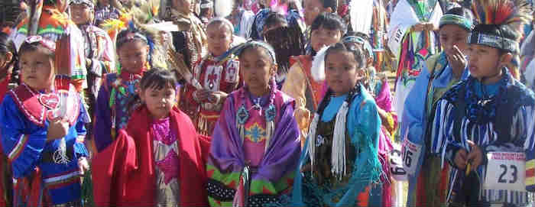

Slide 17
Sources
Johnston, Basil (1990). Ojibway Heritage.
Ngo Dwe Waangizid Anishinaabe is the Preamble to the Anishinabek Nation Constitution
Kinoomaadiewinan Anishinaabe Bimaadizinwin, collected teachings shared with Nokiiwin Tribal Council by local elder, Dorothy with Anishinawbe Mushkiki
Teachings from local elders

