Slide 1

Selling to
City of Thunder Bay
Supply Management
D. Munshaw, CPP, SCSMP, SCMP
Manager Supply Management

Slide 2




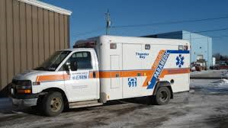

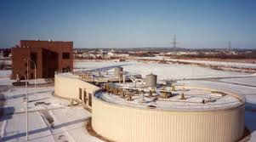



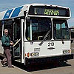
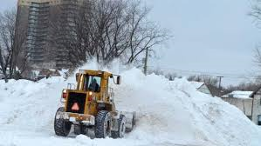







Slide 3


Broader Public Sector Procurement, know the rules

Slide 4
City “Rules”
Over $60,000 Public tender call
$5 – $60,000 At least 3 quotes
< $5,000 , most beneficial & economical
Visit our web site for complete details

Slide 5
Buying Process
Departments generally buy direct under
$15,000.
Supply begins to get involved between
$15 - 60,000.
Supply controls the process above
$60,000 .

Slide 6
Selling Strategies
Under $60k, view the CTB as many different accounts & establish relationships with depts
Review CTB web site, all depts, staff and contact information listed
Over $60k, know Supply staff, watch local paper & Merx for bid opportunities
Watch capital budget approval process

Slide 7
Our “SEEP” Commitment:
We will:
Promote sustainable, social,
environmental and ethical procurement
We require:
Suppliers that exhibits leadership in
environmental & social responsibility

Slide 8

Sometimes you need help to find your way….
Visit Supply’s web site for information

Slide 9






Supply’s Local Partners

Slide 10

Public purchasing, learn the process, it’s not magic.....

Slide 11
How to Win
Know the customer & their needs
Understand the rules & process
Watch for opportunities
Built relationships
Competed to win
Offer fair value for money

Slide 12

Success = K + R + VM

Slide 13
Reason for Un-Successes
Poor customer knowledge
Failure to demonstrate, experience, value added, environmental etc..
Non-compliance with process & rules
(ie: missed mandatory criteria,
delivered late, in pencil, unsigned)
Ask for a debrief, listen & learn

Slide 14






Buying Trends
BPS Procurement Directive
Buyandsell.gc.ca
Government Canada

Slide 15
Top “5 ” Buying Trends
#1 Use of Procurement Portals
#2 Increased Group Buying
#3 Electronic Bid Submissions
#4 Longer Term Agreements
#5 Total Cost & SEEP Consideration

Slide 16


Slide 17
Does the City maintain a bidders list? No.
IS there a local preference policy? No.
How do I arrange to see a department?
Contact departments directly, see web site & blue pages for department listings
Can I view opportunities on line? Yes

Slide 18


Questions?

