Slide 1
Ontario Region: Overview
Annual Information Session
November 2017

Slide 2
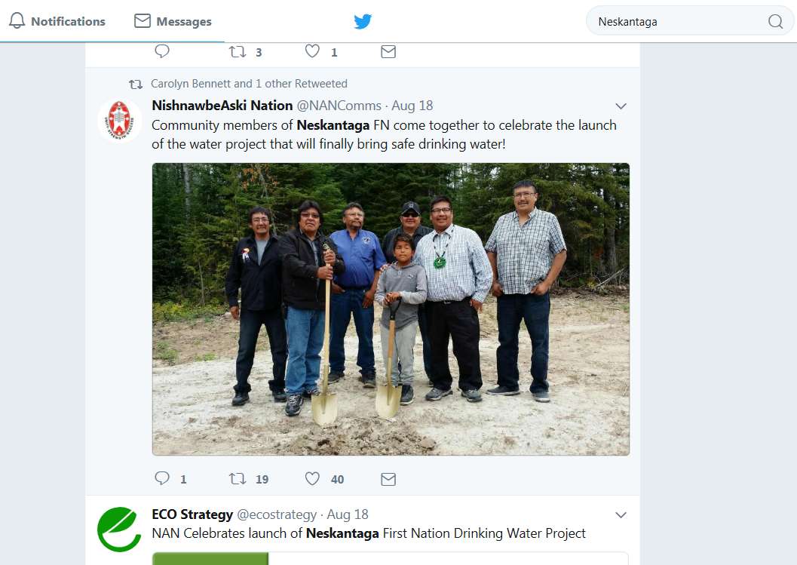
Water Treatment Plant – Neskantaga First Nation

Slide 3
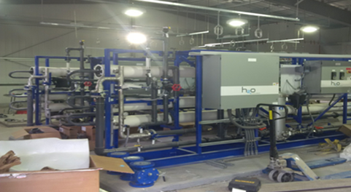
Water Treatment Plant – Slate Falls First Nation

Slide 4
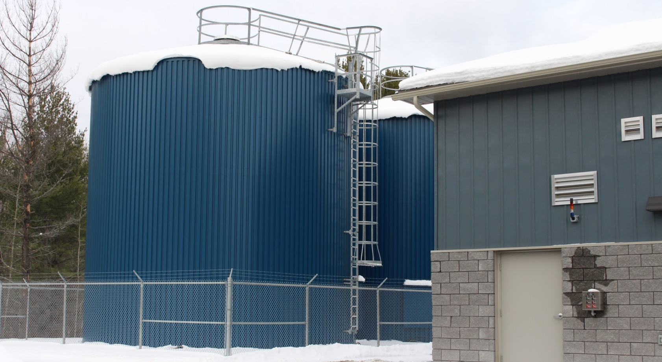
Water Treatment Plant – Serpent River First Nation

Slide 5
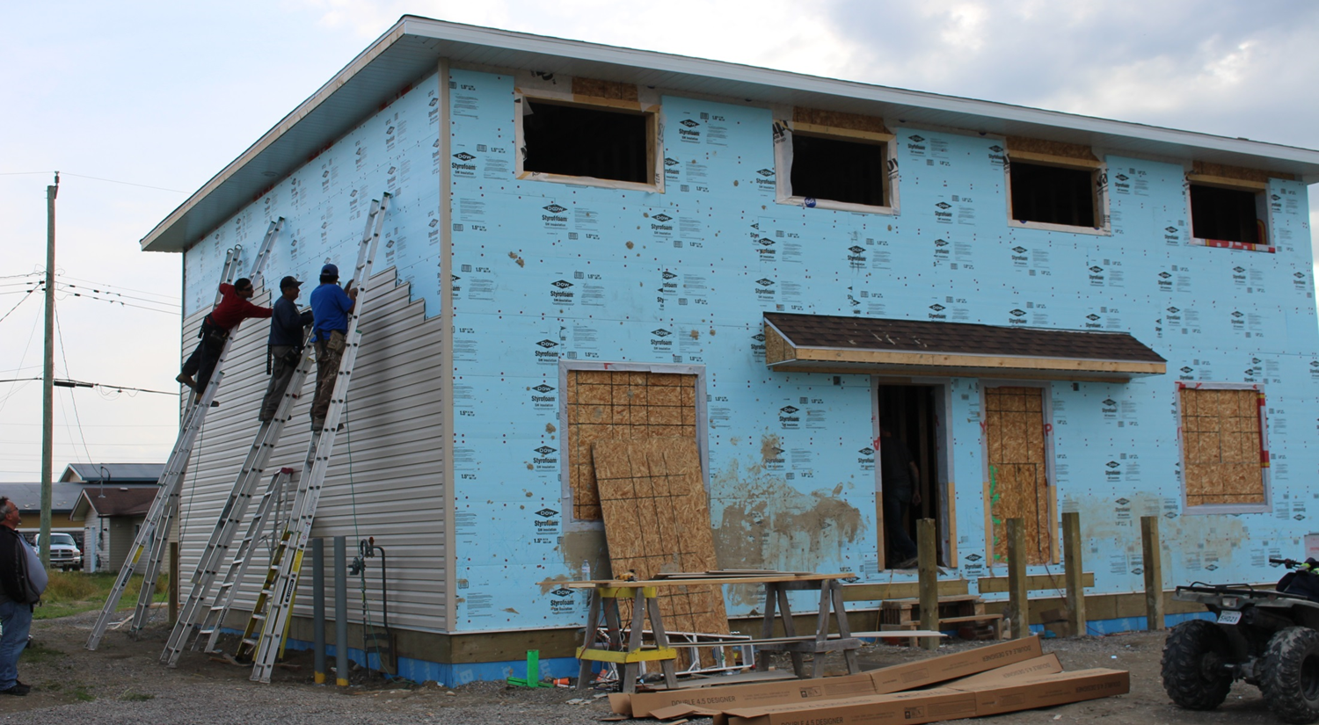
Housing – Long Lake #58 First Nation

Slide 6
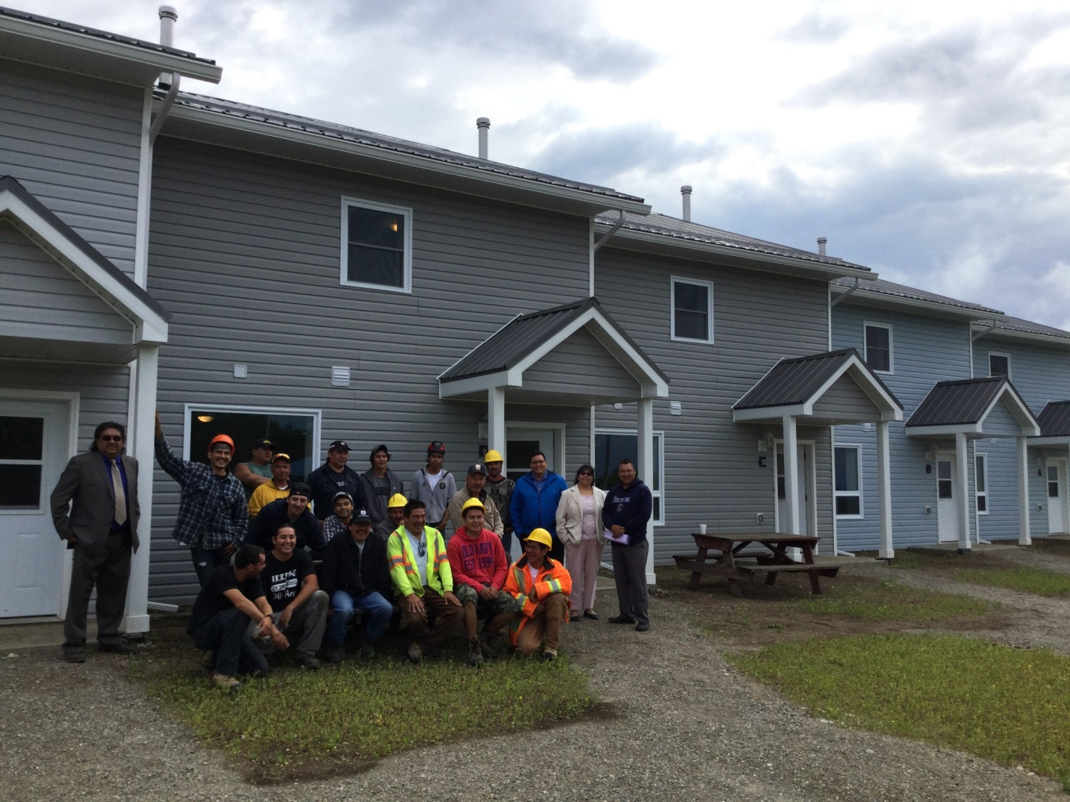
Housing Projects – Wikwemikong First Nation

Slide 7
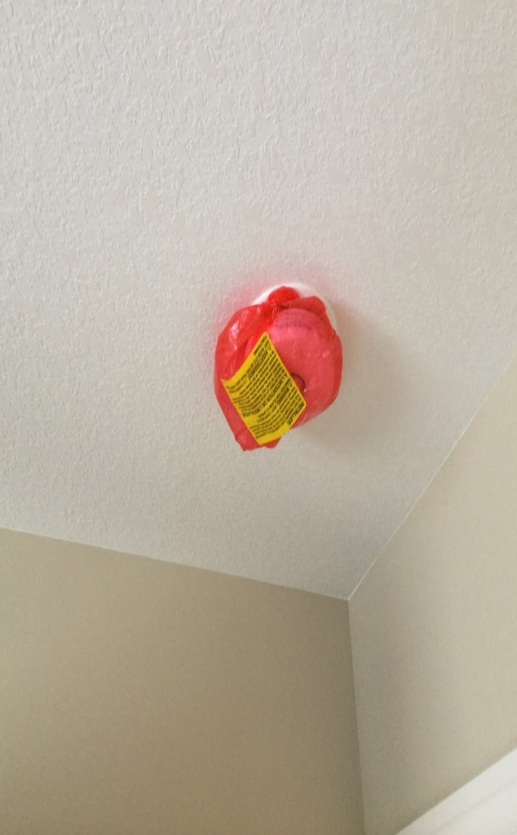
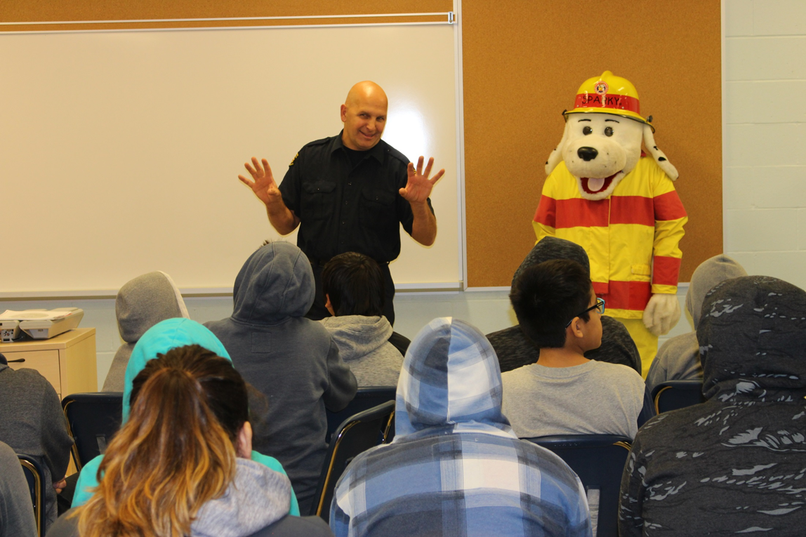
Fire Safety and Education

Slide 8
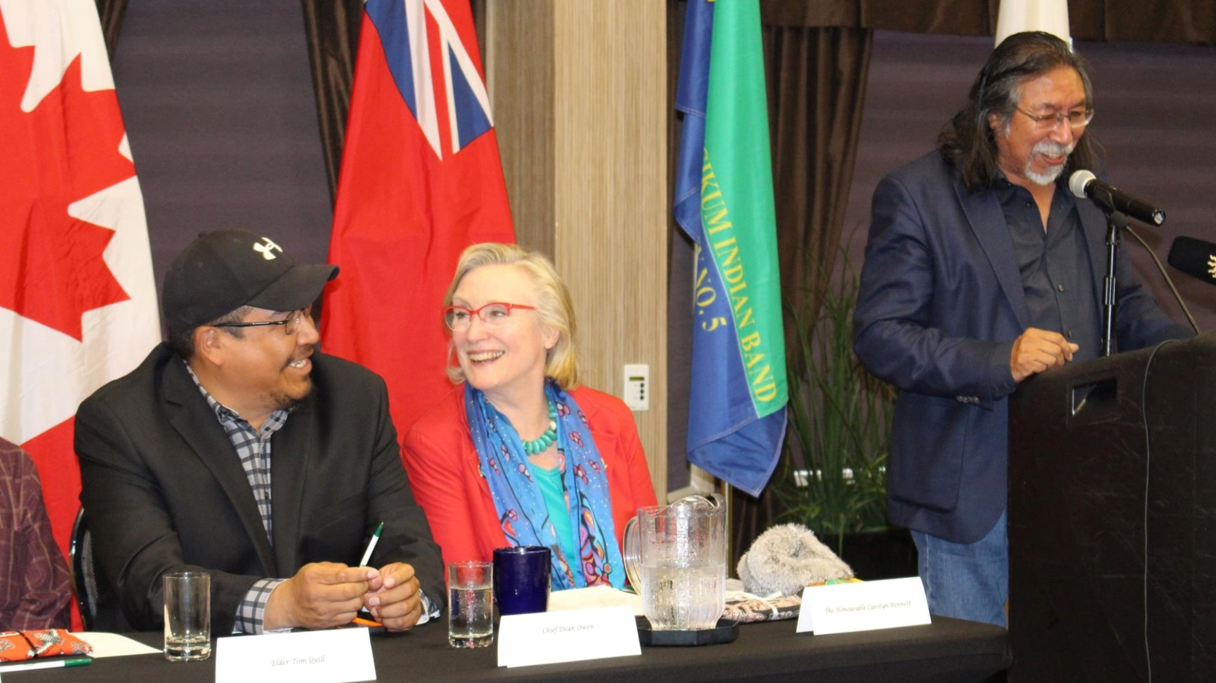
Electrification - Pikangikum Announcement

Slide 9
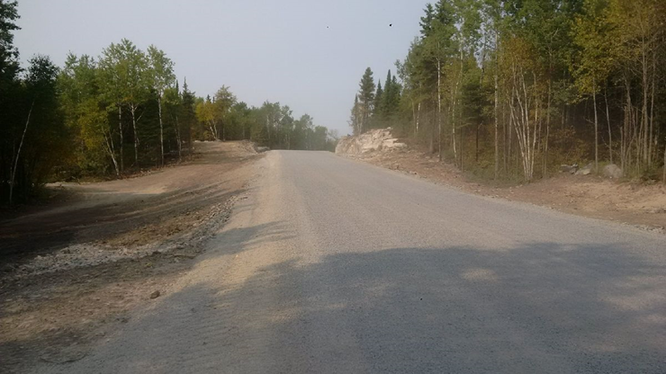
Shoal Lake No. 40 First Nation– Freedom Road

Slide 10
Ontario Region Treaty and First Nation Communities

