Slide 1
Accessing benefits & credits

Slide 2
Benefits and credits
Don’t miss out on the benefits and credits you may be eligible for!
File your income tax and benefit return every year to receive your benefit and credit payments, even if
you did not receive income in the year or if your
income was tax exempt.

Slide 3
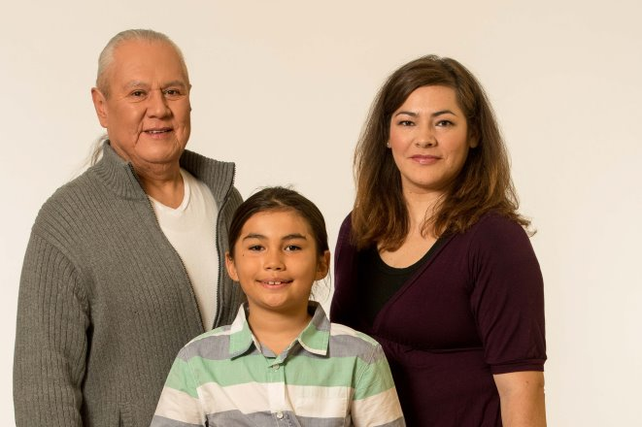
Canada child benefit
The Canada child benefit (CCB) is a tax-free payment made to eligible families to help them with the cost of raising children under 18 years of age.
Applying for the CCB will also register your child for any related provincial or territorial programs.

Slide 4
CCB payments July 2017 to June 2018
2016 family net income | Per child <6 (monthly) | Per child 6 to 17 (monthly)
$0 to 30,000 | $533.33 | $450.00
$35,000 | $504.16 | $420.83
$40,000 | $475.00 | $391.66
$45,000 | $445.83 | $362.50
$55,000 | $387.50 | $304.16
$65,000 | $329.16 | $245.83
$75,000 | $302.49 | $219.16

Slide 5
Are you eligible?
To be eligible for the CCB, you must meet all of the following conditions:
you live with the child, and the child is under 18 years of age;
you are primarily responsible for the care and upbringing of the child; and
you are a resident of Canada for tax purposes.

Slide 6
When should you apply for the CCB?
Apply for the CCB as soon as possible after:
your child is born
a child starts to live with you
you or your spouse or common-law partner meet the eligibility conditions
You should apply even if:
you share custody of your child
your child is living with you temporarily

Slide 7
How do you apply for the CCB?
You can apply for the CCB in one of the following ways:
Automated Benefits Application
My Account at Canada.ca/my-cra-account
Form RC66, Canada Child Benefits Application

Slide 8
Child disability benefit
The child disability benefit (CDB) a tax-free benefit for families who care for a child under the age of 18 who is eligible for the disability tax credit.
A child is eligible for the disability tax credit when a medical practitioner confirms to the CRA that the child has a severe and prolonged impairment in physical or mental functions on Form T2201, and the CRA approves the form.
The CDB is paid monthly with the CCB.

Slide 9
CDB payments – June 2017 to July 2018
Family net Income (2016) | One eligible dependant ($/month) | Two eligible dependants ($/month) | Three eligible dependants ($/month)
$0 to $65,000 | $227.50 | $455.00 | $682.50
$70,000 | $214.16 | $431.25 | $658.75
$75,000 | $200.83 | $470.50 | $635.00
$80,000 | $187.50 | $383.75 | $611.25

Slide 10
GST/HST credit
The GST/HST credit is a tax-free payment that helps individuals and families with low or modest incomes offset some of the GST or HST that they pay.
You don’t have to apply. When you file your income tax and benefit return, the CRA will issue payments if they determine you are eligible for it.
It is paid four times a year, around the 5th of July, October, January, and April.

Slide 11
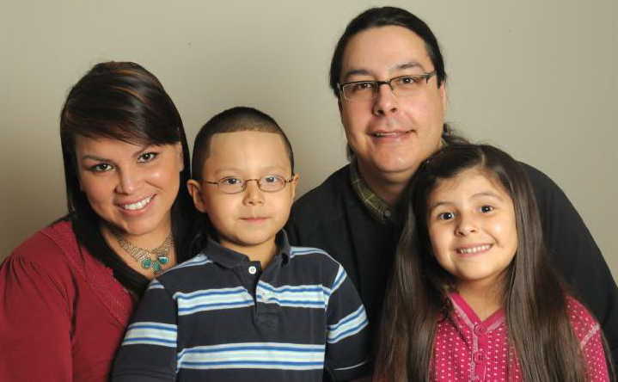
How is your credit calculated?
The CRA calculates your GST/HST credit based on:
the number of children you have registered with the CRA for benefits and credits; and
your family net income

Slide 12
GST/HST credit – single person July 2017 to June 2018
Single person
Family net income (2016) | No children ($/year) | 1 child ($/year) | 2 children ($/year) | 3 children ($/year) | 4 children ($/year)
under $8,948 | $280.00 | $707.00 | $854.00 | $1,001.00 | $1,148.00
$10,000 | $298.52 | $707.00 | $854.00 | $1,001.00 | $1,148.00
$15,000 | $398.52 | $707.00 | $854.00 | $1,001.00 | $1,148.00
$20,000 | $427.00 | $707.00 | $854.00 | $1,001.00 | $1,148.00
$25,000 | $427.00 | $707.00 | $854.00 | $1,001.00 | $1,148.00
$30,000 | $427.00 | $707.00 | $854.00 | $1,001.00 | $1,148.00

Slide 13
GST/HST credit – couple July 2017 to June 2018
Married/common-law
Family net income (2016) | No children ($/year) | 1 child ($/year) | 2 children ($/year) | 3 children ($/year) | 4 children ($/year)
under $35,926 | $560.00 | $707.00 | $854.00 | $1,001.00 | $1,148.00
$37,000 | $531.44 | $678.44 | $825.44 | $972.44 | $1,119.44
$38,000 | $481.44 | $628.44 | $775.44 | $922.44 | $1,069.44
$39,000 | $431.44 | $578.44 | $725.44 | $872.44 | $1,019.44
$40,000 | $381.44 | $528.44 | $675.44 | $822.44 | $969.44
$42,000 | $281.44 | $428.44 | $575.44 | $722.44 | $869.44

Slide 14
GST/HST credit – Eligibility
You may be eligible for this credit if, you are a resident of Canada and at least one of the following applies:
you are 19 years of age or older
you have (or previously had) a spouse or common-law partner
you are (or previously were) a parent and live (or previously lived) with your child

Slide 15
What do you have to do to continue to receive your payments?
File your income tax and benefit return every year
Keep your personal information up to date

Slide 16
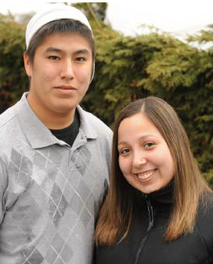
How much will YOU get?
To get an estimate of the benefit and credit payments you may be eligible to receive, go to Canada.ca/child-family-benefits-calculator

Slide 17
Community Volunteer Income Tax Program
CVITP volunteers prepare income tax and benefit returns for those who are eligible, for free!

Slide 18
Who is eligible?
The program can help a person with :
a simple tax situation and a modest income
Suggested family income (except for Quebec)
Marital status | Family income
Individual | $30,000
Couple | $40,000
Individual with a dependant | $35,000
interest income less than $1,000

Slide 19
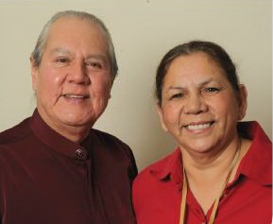
Lend a hand!
The CRA provides participating community organization and their volunteers with:
training
free income tax preparation software
access to a toll-free dedicated telephone line
surplus computers (when available)
promotional products and services
To become a participating community organization, register online at Canada.ca/taxes-volunteer

Slide 20
Types of Training Offered
The CRA provides participating community organization and their volunteers with a multitude of training courses, including:
Dependants & Benefits/Medical & Disability Tax Credits
EFILE/UFile Software
Indigenous Peoples & Northern Residents
Seniors
Students
Newcomers

Slide 21
Successes
47 communities registered for CVITP
1379 participated in presentations
108 community visits
5 in-person CVITP training sessions
60 volunteers registered for CVITP

Slide 22
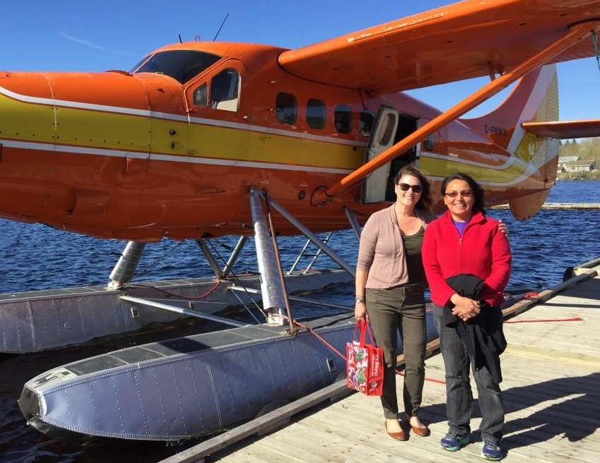
Successes – Deer Lake
“Deer Lake First Nation was an extremely busy visit for both the CRA and SC. It really showed how impactful our joint Outreach services were for this community.
A lasting impression from the Deer Lake visit was when a family of five came in to see me to get help with a CCB questionnaire they received. Their CCB benefits had been stopped due to the couple not sending in the questionnaire by the due date. They were shy at first, but I feel I made a connection with them by listening to what had happened to cause their marital status to be questioned by CRA. We called the CRA benefits line together and once we understood why the marital status was being questioned, we began gathering the appropriate proof and prepared a package to send to the CRA. By seeing the children right in front of me, smiling and playing, it brought home just how dire it can be when people’s benefits get cut off for not providing the information requested. This was not an “account” or a “case” but a real family who desperately needed help to reinstate their CCB benefits in order to survive.
Left to right: Erin Jeffery (CRA) and June Trout (SC)
It was my mission to help this family get their benefits reinstated as soon as possible. The couple thanked me and shook my hand when we were finished, they felt that someone took the time and cared enough to fully listen to their situation and do what it took to fix the problem.”
- Erin Jeffery, Outreach Officer, CRA

Slide 23
Successes – Sachigo Lake
“My name is Genevieve Kaminawash.
I am a volunteer for doing taxes in our community it has been great and it also helps people that cannot afford to pay their fees from our local Northern store here.
I mainly help my clients for which I am Ontario works Administrator.”
- Genevieve Kaminawash

Slide 24
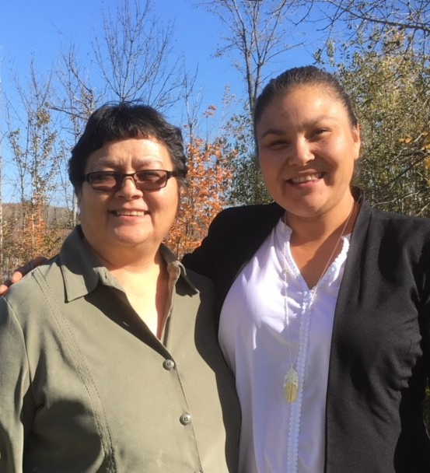
Successes – Wikwemikong
“We are thankful to be a part of the Community Volunteer Income Tax Program (CVITP). Since 2014, our participation in the program has enabled us to complete 1,692 income tax returns. The program has ensured that Wikwemikong First Nation community members receive the benefits and credits available to them from new filers, single parents to pensioners.
The CVITP resources have directly contributed to the ongoing development and overall success of our community volunteers including online training, webinars, dedicated helpline, as well as U-file software. With CVITP’s assistance, we have grown from 2 volunteers in 2014 to 10 volunteers in 2017.
This past year, we participated in a joint outreach effort between the Canada Revenue Agency and Service Canada, the joint training was both informative and helpful. Not only were we able to provide training to our volunteers, but we were able to provide workshops to community members on the CPP; OAS; Canada Child Benefit and other tax credit information.
Canada’s Indigenous communities face unique challenges such as on-reserve tax specific questions; language barriers; valid identification; and assistance with filing final returns. We hope that the Community Volunteer Income Tax Program will expand to assist more Indigenous peoples in communities across Canada.”
- Jocelyn Bebamikawe
Right to left: Jennifer Peltier & Janine Pitawanakwat

Slide 25
Moving forward
Community Volunteer Income Tax Program
In-person CVITP training – tax and software training
Teaching Tax training
Information sessions (various segment groups/topics)
Lynda Cam: Lynda.Cam@cra-arc.gc.ca 1-888-716-7014
Natasha Persaud: Natasha.Persaud@cra-arc.gc.ca 1-877-490-2293

Slide 26
For more information
CRA web addresses and phone numbers
Child and family benefits calculator | Canada.ca/child-family-benefits-calculator
Child and family benefits | Canada.ca/child-family-benefits
Disability tax credit | Canada.ca/disability-tax-credit
CVITP | Canada.ca/taxes-volunteer
CRA forms and publications | Canada.ca/cra-forms
My Account | Canada.ca/my-cra-account
E-services | Canada.ca/cra-electronic-services
Benefit enquiries | 1-800-387-1193
Individual enquiries (get forms) | 1-800-959-8281

