Slide 1
Creating Safe Inclusive Spaces
It Starts with You!
Notes:
Brief history of work of the Network,
Roots of Anti-oppressive work in activism work with families of sister in spirit
Anti-oppression is a way of naming oppression that happens against certain people, based on their identities, and then a way to work toward ending that mistreatment, oppression, violence toward that particular group.
Six main lenses; racism, sexism, heterosexism, ableism, ageism, and class oppression
People are excluded on a regular basis because of the colour of their skin, their gender, their sexual orientation, their abilities, their age, and their class.

Slide 2
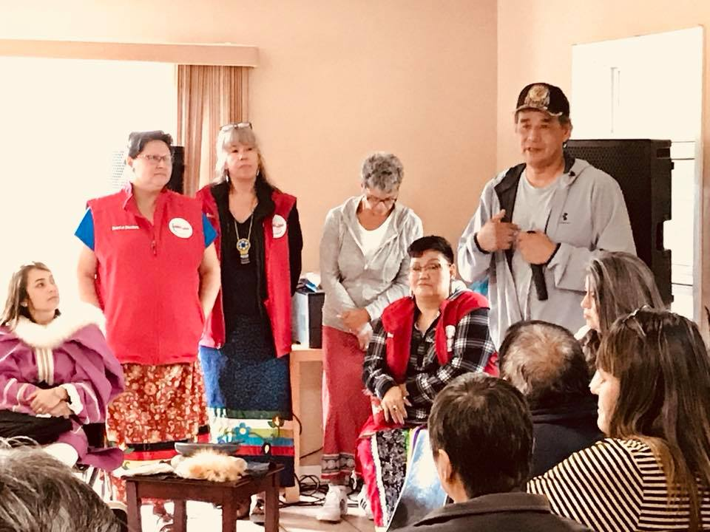
National Indigenous Survivors of Child Welfare Network
The National Indigenous Survivors of Child Welfare Network is a national coalition of Indigenous people (Métis, First Nation and Inuit) and organizations which provides leadership, support and a voice for Indigenous people affected by Indigenous Child Removal Systems in Canada and Internationally, regardless of where they reside,
The Network is a not-for-profit organization comprised of an Indigenous board of directors. Each director has their own story of being apprehended by social services, being torn from their communities and families and placed in a non-Indigenous environment. Our work is by survivors for survivors.

Slide 3
Bringing folks together

Slide 4
Introspection & Discomfort
Unlearning – harmful stereotypes, prejudices, violence, learned behaviour is looking at
how/if we contribute to the status quo – sexism, homophobia, violence, gossip, lateral violence,
fear, ignorance…..
Where did we learn our fears? Are they real? What are we afraid of?
Confronting ourselves and our own roles of power and oppression in our communities and the
bigger picture.
Being First Nation, Metis or Inuit doesn’t mean you aren’t capable of uttering discriminatory,
sexist, homophobic/transphobic
etc., and not realizing the power that you hold, and how your actions affect other people you
will inevitably fall into sustaining
and contributing to the larger picture of perpetuating harm.
When you don’t know what you don’t know, how do you know?
Notes:
Unlearning – harmful stereotypes, prejudices, violence, learned behaviour, how/if we contribute to the status quo – sexism, homophobia, violence, gossip,
Confronting ourselves and our own roles of power and oppression in our communities and the bigger picture.
Being First Nation, Metis or Inuit doesn’t mean you aren’t capable of uttering discriminatory, sexist, homophobic/transphobic etc., and not realizing the power that you hold, and how your actions affect other people you will inevitably fall into sustaining and contributing to the larger picture of perpetuating harm.
When you don’t know what you don’t know, how do you know?

Slide 5
Dismantling stereotypes, fear and ignorance
GENDER
In our workplaces and cultural spaces we must ask questions like:
Does your workplace have anti-discrimination or anti-harassment policies or safer spaces agreement?
Does your workplace offer sensitivity/awareness training on human rights issues such as sexism/racism in order to ensure a harassment-free, inclusive workplace?
Would you be uncomfortable working with someone who was gay, lesbian, or bisexual?
Has anyone in your workplace ever experienced personal harassment or violence as a result of their sexual orientation?
When getting to know a new employee, are you sensitive to the possibility that they may be gay, lesbian, transgender or bisexual by not asking or assuming they are straight (CIS)
Are jokes about lesbians, gays, or bisexuals accepted at your workplace as just another way of releasing tension and having fun?
Does your benefit package acknowledge same-sex relationships? (Heterosexism Enquirer Magazine, 2000)
Notes:
Socialization tells us girls wear pink, boys wear blue, there is no room for deviation and any thing outside of the “norm’ we are afraid of to make space for 2spirit, Lesbian, gay, queer and bi folks who don’t feel safe in cultural spaces in our communities.
Majority of people don’t see things beyond their OWN experiences.
Heterosexism is dominant in the culture, and difference is not supported or encouraged.

Slide 6
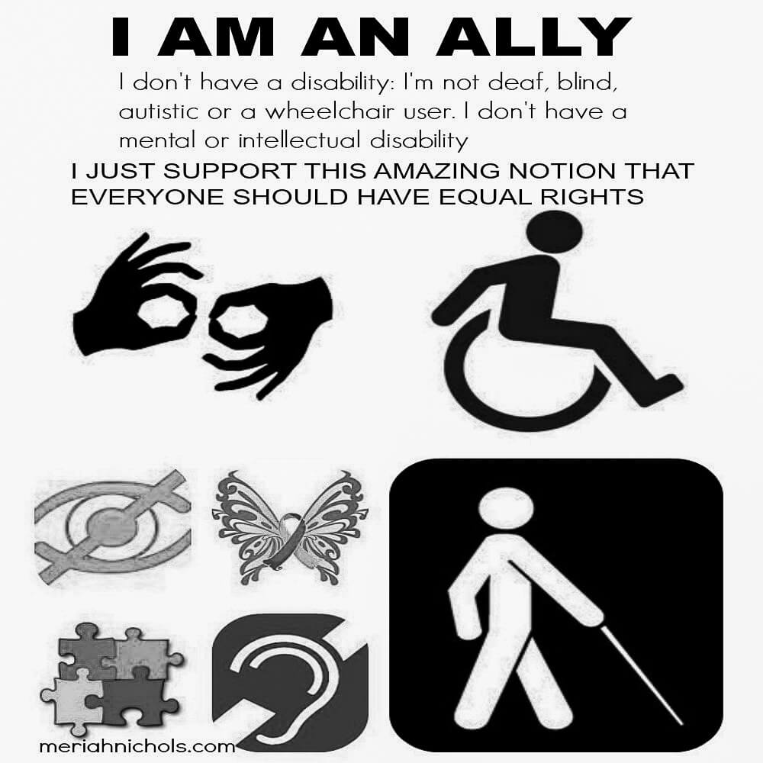
Ableism
We can’t imagine a world where things are inaccessible to us – most of us take for granted that our needs will be met everyday.
For this who are handicapped, blind, lessen mobility, disabled, hearing impaired, invisible disabilities, mentally ill/challenged every day is a challenge to have access, mobility, and to be seen,
We should not feel pity for this group, nor fall into tokenist hiring policies, but instead realize their potential as valued members of society who make valuable contributions to the world.
Consider their needs in workplace policies and cultural events that are inclusive, accessible and respectful.

Slide 7
Sexual harassment/violence
Jokes about snagging at ceremony – for survivors who are coming back to culture for first time and are thirsty for knowledge/culture they are vulnerable
Many survivors have reported being taken advantage of by male helpers or some Elders and are scared to go back to cultural events such as sweat lodge
Vetting Elders, firekeepers, helpers, volunteers and other survivors about sexual harassment/violence is and what behaviours are not tolerated in this spaces.
Having a way for survivors/ community members to safely disclose sexual harassment/violence and a system to follow through.
Clear, implemented sexual harassment policy in place with measures to follow through on disciplinary action – criminal if applicable.

Slide 8
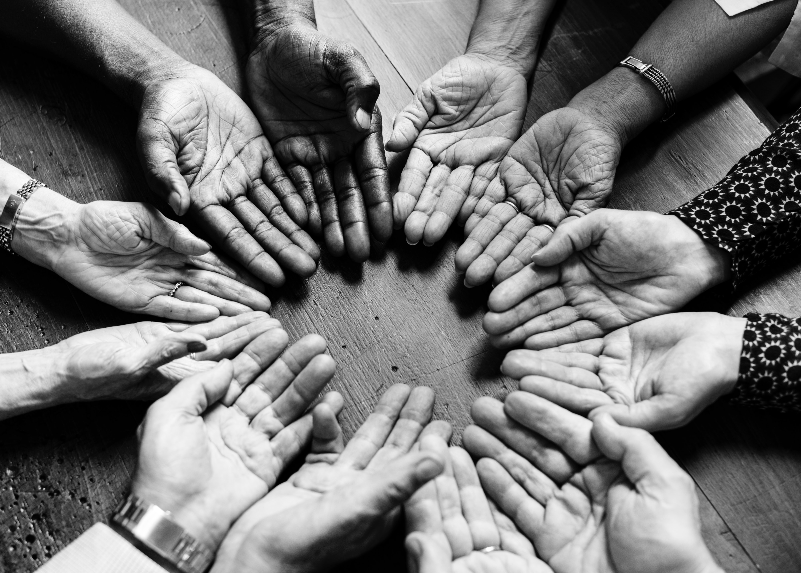
Naming and Identifying Violence and harassment in our workplaces and cultural spaces
“Violence in the workplace is any incident(s) in which an employee is threatened, assaulted or abused during the course of their employment that may cause physical or psychological harm. This includes threats, attempted or actual assault, application of force, verbal abuse or harassment.”
Perpetrators can include clients, members of the public, co-workers or supervisors
Workplace violence is not limited to incidents that occur within traditional workplaces. Violence can occur in the workplace, but also at other functions and locations related to work, such as conferences, training sessions, social gatherings, while travelling for work, in a client’s home, or in other work-related locations.
t

Slide 9
In creating spaces for survivors, clients, employees – folks want to feel safe
Making sure the Elders, firekeepers, facilitators are “safe”
By “safe” meaning they are willing to/or have adhered to cultural practices that are inclusive, anti-violent, anti-oppressive practices
Vetted – they are known to work in a way that is inclusive, supportive and safe
Asking Elders where they got their knowledge and teachings from, who claims them in their community
A clear anti oppressive/anti violence/sexual harassment policy that sets out expected behaviour and unacceptable harmful behaviour
In some organizations standard safety clearance – CPIC, security clearance working with vulnerable folks
ACCOUTABILITY – CALLING IN
Restorative circles – with Elder (s) in ceremony, willingness
Offender/offended
the problems that creates people to respond in violent ways are the problems - the individual is not the problem - the problems are societal - economic, environmental etc
As a whole we have to start taking responsibility also - that’s why I say community also - because from an Indigenous Worldview it’s about being in relationship and being responsible for our role to the whole

Slide 10
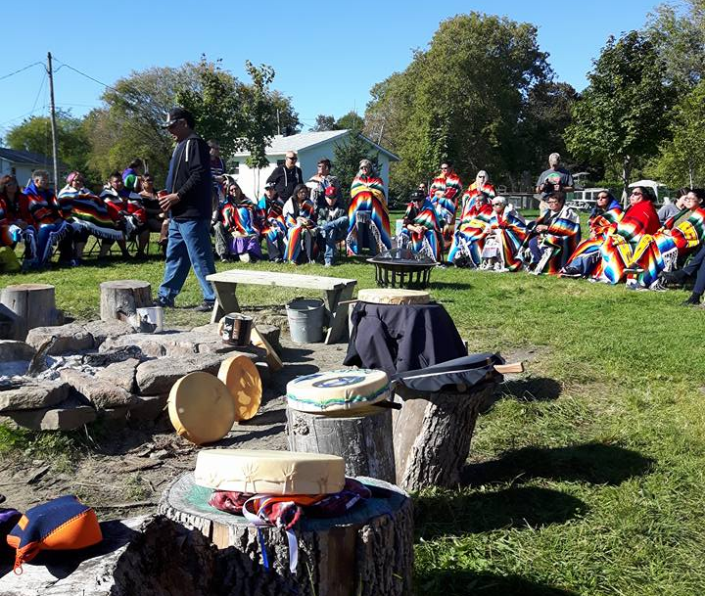
Safer spaces agreement/policy
Setting a standard that is inclusive, respectful and safe for folks in workplace, cultural events and gatherings
Accommodation – making sure your reaching folks who typically aren’t included
Challenge yourself to be courageously honest and open, willing to take risks and change the dialogue
Challenge the behavior, not the person. Be sensitive and promote open dialogue.

Slide 11
